Slide 1
WEST Member Meeting
Shared Print, Shared Future: The Path Forward for WEST
July 23, 2027
9am-10:30am PDT/MST
10am-11:30am MDT
11-12:30pm CDT
12-1:30pm EDT
Notes:
Good morning and afternoon, everyone - thank you so much for joining us today. My name is Alison Wohlers, and I am the WEST Program Manager.

Slide 2
Today’s Agenda
Shared Print, Shared Future: The Path Forward for WEST
Welcome
State of WEST
Sustainability Planning
  Exploratory Pathways
  Next Steps
Thank You & wrap-up
Notes:
Alison Wohlers
This is our roadmap for today. After our welcome, we’ll set the stage for sustainability planning by looking holistically at the state of WEST. Much of what I’ll be sharing was in fact part of a series of discussions and exercises the Executive Committee engaged in as part of the sustainability planning. With that foundation our Executive Chair will go over the exploratory pathways that emerged out of initial planning, what our status is in exploring those pathways, and what the next steps are.
Throughout today’s meeting we invite your questions and comments and there are number of ways to engage during the meeting
Chat
Google doc for questions and feedback: https://docs.google.com/document/d/1Ae9djsIgNcN-jCPK7GcaiSsibN-dDgZuUxkcFiCJBtk/edit?usp=sharing
Raise your hand and share verbally
Finally, I want to point everyone to the Agenda: https://drive.google.com/file/d/1-KM4GMkfzh_5QS1-q6KsxNhXpVxUwNJO/view?usp=sharing
And the Background document: https://drive.google.com/file/d/1w9lfIwsM-2ua9ZTTFjBFe4KO1p58cO5J/view?usp=sharing
And with that I will hand things over to Shari Laster, our WEST Executive Committee chair in 2026 and Director of the Systemwide Library Facilities for the University of California Libraries.

Slide 3
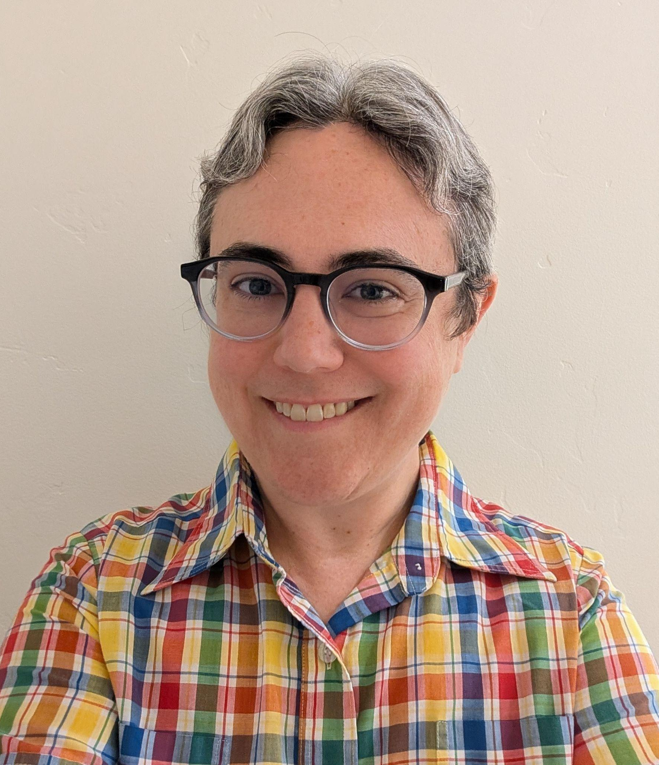
Welcome
Shari Laster
WEST Executive Committee Chair
Director, Systemwide Library Facilities, UC Libraries
Notes:
Shari Laster - Welcome

Slide 4
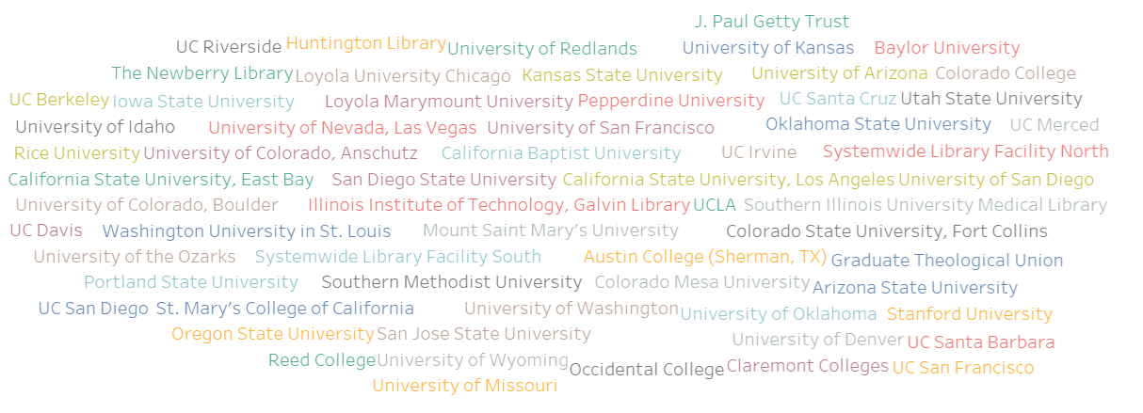
Welcome to continuing and new WEST members!
Notes:
Shari Laster

Slide 5
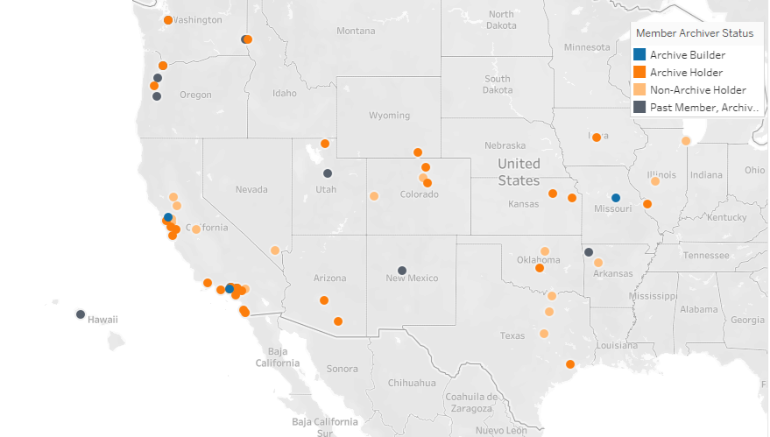
WEST Members
61 current members
3 Archive Builders
36 Archive Holders
22 non-archive holders
+12 past members who continue as Archive Holders
Notes:
Shari Laster

Slide 6
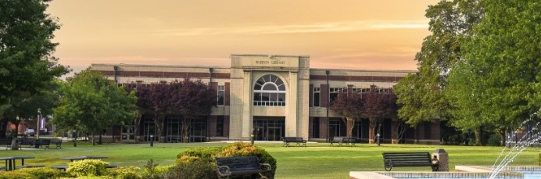
Welcome to WEST!
University of the Ozarks
Notes:
Shari Laster
https://cdlib.org/west/about-west/west-pilots-and-projects/west-consulting-services-pilot/

Slide 7
WEST - what’s your why?
Zoom poll with optional chat participation
Notes:
Shari Laster
Nika will deploy the poll and share the results
Alison will time it to a minute and give a 15 second warning
Survey options
Institutional responsibility to contribute to the preservation of the print corpus
Expand access for my institution's users
Reclaim or repurpose stacks space by integrating shared print into my local print collection strategy
Desire to make content in my institution's collection more visible and available
Other - tell us more! (please tell us more in the chat or Google document if you're willing)

Slide 8
State of WEST
Notes:
Alison
Thank you, Shari!
As many of your know WEST regularly engages in program assessment of various kinds, which have led to strategic pivots over our evolution as a collaboration. The last significant assessment and strategic planning effort took place in 2023. This effort became known as the Future of WEST and resulted in several strategic pivots, including a reduction to development capacity that realized new cost savings, changes to archiving workflows to lessen workload and achieve new efficiencies, and a pilot in partnership with Internet Archive to digitize WEST archived titles.
Now, we are once again taking time to examine our program, how it continues to meet the needs it was built for, and how we can evolve the collaboration to best serve libraries. In light of continued, significant financial and organizational impacts on libraries across the country, we are framing our assessment and planning explicitly in terms of how we ensure the sustainability of the shared print archives we have built together and the benefits it produces for member libraries and the broader community. New members have joined WEST over the last three years, but other members have had to make the difficult decision to cancel due to financial and other resourcing constraints. The value proposition of WEST continues to be strong, but we also recognize signals that long-term sustainability requires us to consider new potential pathways proactively.
As I hope this report on the state of WEST communicates, we are engaging in these sustainability conversations at a point of strength; WEST has a strong core membership and healthy program reserves that could, if we decide it is strategic, enable intentional, deliberate pivots or transformations.
In the following slides, I’ll talk about the state of WEST using a sustainability framework of three pillars - value proposition, community investment, and resources.

Slide 9
Value Proposition - Maintenance and Innovation
Maintaining
Innovating
Archiving operations
Aggregated member holdings data sets
Policies and standards
Technical infrastructure
Collection assessment consulting service
Communication resources
Partnership with HathiTrust and CDL to expand our technical infrastructure to support monographs
Notes:
Alison
WEST orchestrates reliable, innovative, and lasting preservation to ensure ready availability of the print scholarly record and enable individual libraries to make strategic collection management and development decisions. As the network of retained serials and journals in WEST has grown, with the establishment of accompanying workflows and policies, WEST’s overt value proposition has shifted further toward facilitating space reclamation via cogent decision-making. But maintenance of the distributed WEST collection continues to be an essential, if more subtle part, of the value proposition.
On the maintenance side, there is a lot humming in the background which not only supports the foundation for all the value proposition - the distributed and shared collection of print serials, but allows us to continue to innovate year over to build new value that matches our members needs.
[maybe comment on the distribution of “what’s your why”]
Institutional responsibility to contribute to the preservation of the print corpus
Expand access for my institution's users
Reclaim or repurpose stacks space by integrating shared print into my local print collection strategy
Desire to make content in my institution's collection more visible and available
Other - tell us more! (please tell us more in the chat or Google document if you're willing)

Slide 10
Community Investment
Participation
A smaller, but mighty portion participate in governance, pilots, and cross-institutional problem solving
64%
retain and provide access to titles in the WEST trust network
77%
submitted bib & holdings data for group analysis and comparison in 2025
Notes:
Alison
The community investment that is desired by (and feasible for) members evolves alongside the value proposition. So as the value proposition evolves we have to continue to consider and assess what community investment indicates a healthy level of engagement in WEST.
This visual summarizes what our current state looks like - over ¾ of member libraries submitted bib and holdings data for group analysis and comparison during the last submission period. Curated data and the ability to engage with it is a critical foundation for facilitating collection decision-making by us as a collaboration and by individual libraries who seek to benefit from the collaboration. Further over 50% of WEST members retain and provide access to titles as part of the trust network. This is especially impressive because our collaboration does not require libraries to commit to retain any titles - we leverage the intersection of our group priorities with the capacity and priorities of individual libraries. These two foundational areas of community investment are demonstrating very healthy levels of engagement. That said we recognize that there are challenges within these areas of investment that we are engaging with through sustainability planning - for example sustainability of the frequency of submitting data - we need to find a new balance of maintaining a really good data set with managing workload that it takes to do that. We also will be engaging in assessment of the retentions, planning for the renewal of commitments at the point of the retention expiration date (which is still about 9 and a ½ years out still, but we want to start those conversations early), and understand the trajectory of what we have left to do in our region to secure the print serial and journal corpus, how that relates to our partner programs and the binational effort amongst U.S. and Canada.
Finally, a small, but might portion of our membership participates in any given time in the governance and smaller pilot projects. Right now there are several WEST members who are serving as early adopters in submitting HathiTrust monographs data to AGUA, now the Shared Print Decision Suite, and the community we have together also creates opportunities for cross-institutional problem solving and that in recent years has really manifested in troubleshooting certain ILS issues in getting data out so we can aggregate it, but also in sharing information about how to leverage the WEST collection and other shared collections in maximizing local collection management - how to talk to different stakeholders about shared collections and how they support strategic withdrawal decisions. We have so many generous colleagues across this membership who are willing to share their expertise and even create resources to share across WEST and beyond.
So we assess community investment in terms of participating in key areas of the program to be very good, however with opportunities for increasing the sustainability of that participation, so we can maintain it over time.
Submitted bib and holdings data - 77% (47 institutions submitted data for collections analysis / 61 current members // for cycles 16 & 17)
Serve as archive holders - 64% (39 institutions are holders or builders / 61 current members)

Slide 11
Community Investment
The push and pull on membership
Strong core membership
New members
Many have acute collection management challenges they are looking to solve
10 members joined between 2021 and 2025
Departing members
Budget and staff capacity (as well as uncertainty)
15 members canceled between 2021 and 2025
47 members have been with WEST since 2011
Notes:
Alison
Community investment is also demonstrated through WEST’s membership trends. WEST continues to have a strong core of long-time members - the majority of our membership has been building and sustaining WEST since its first official membership year (2011).
And while we do not consider membership growth as an innate marker of success, we are viewing the recent downward trend in membership as a signal to consider in overall assessment of sustainability and whether there are paths we can take as a program that would sustainably expand who is able to participate.

Slide 12
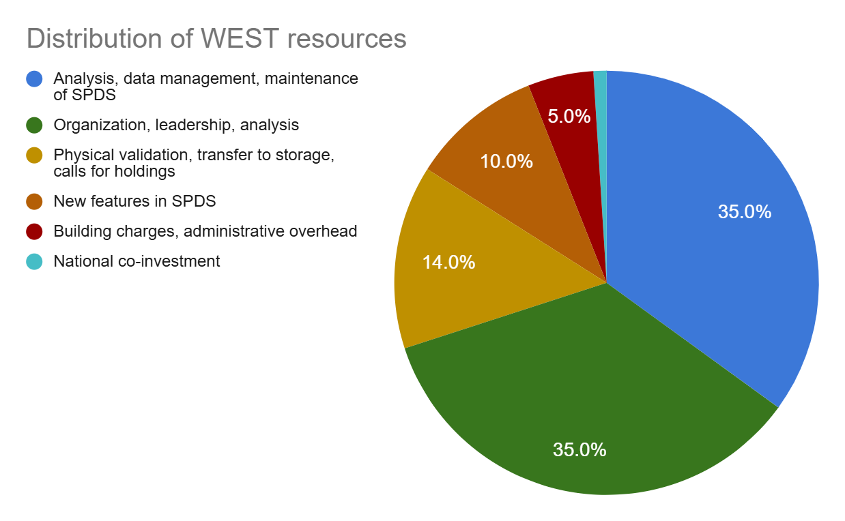
Resources
Approximate Distribution
Notes:
Alison
Finally I want to report on the state of WEST from the perspective of resources.
WEST’s resources are supporting the desired function of the program. The bulk of WEST’s budget reflects an investment in data, analysis, and project management, which aligns with WEST’s evolving value proposition.
However, you may notice that national co-investment is a tiny portion of our budget and yet an increasingly important part of the vision for the future.

Slide 13
Resourcing
Resilience
Membership attrition and salary increases → operational deficit
Formalized the program reserves and temporarily offset the deficit to avoid fee increases
Current fiscal year
Projecting a continued balanced budget and small buffer
Completed transition from grant subsidies to being fully member-sustained
FY 2019
FY 2021 - FY 2023
FY 2027
FY 2020
FY 2024 - FY 2026
Balanced budget; small buffer
Future of WEST service and operational cost rebalance
Balanced budget; small buffer
Notes:
WEST’s resources have allowed for flexibility over time to address revenue changes without significant negative impact to continuing members.
We experienced pronounced membership attrition around COVID which resulted in an operational deficit. We used newly formalized program reserves to offset that deficit in the short-term while we moved through an intentional assessment and strategic planning process to rebalance services and costs - that was the Future of WEST work.
At this stage the budget is balanced and we are projecting it to continue to be so with a small buffer to grow the program reserves.
In assessing the sustainability and resilience of WEST’s resources, the Executive also surfaced questions to consider further about the equity and proportionality of the fee model. The structure of WEST’s fee model reflects a priority to maintain stability and predictability for its members, but in that it can lack flexibility.

Slide 14
Resourcing
Resilience, continued
Budget is balanced
Program reserves are healthy
Small buffer to add to program reserves
Approximately 25% of operating costs for FY 26-27
Keeping in mind that we don’t have much margin to grow the program reserves or start new services, the evolution of WEST will be through collaboration, rather than growing as an individual program.

Slide 15

In summary
The value proposition of WEST continues to be strong, but we also recognize signals that long-term sustainability requires us to consider new potential pathways.

Slide 16
Pathways we are exploring
Shared Print, Shared Future: The Path Forward for WEST
Notes:
We want to acknowledge and thank Educopia who toward the end of last year when the Executive Committee began its sustainability thinking, offered free consultation sessions, extensives resources, and a workshop - all on organizational transitions. We’ve leveraged their resources a great deal and have found them very useful.

Slide 17
Strategic Positioning
The Executive Committee has entered into these explorations without a predisposition to one particular direction; rather, we are aiming to stay strategically open and member-responsive.

Slide 18
Desired outcomes
Preserve the shared print collection built by WEST members
Increase overall resiliency for the growth and maintenance of shared print
Decrease aggregate cost and/or increase value to individual WEST member libraries to participate in shared print programs
Improve member experience and efficiencies
  Streamline shared print activities for member libraries
  Reduce duplication of work
  Offer interconnected services
Strengthen the national shared print ecosystem through expanding the breadth and depth of retained collections, as well as intentional redundancies

Slide 19
Pathway #1: Deep Collaboration - Core Infrastructure Partnership
What This Pathway Means:
WEST increases its alignment with other regional and national shared print programs to pool technical infrastructure, reduce duplication, jointly steward retention commitments, and streamline validation and access workflows.
This assumes WEST continues to exist as a program, but with a lighter operational footprint supported by shared tools, coordinated processes, and potentially co-staffing arrangements.
Notes:
The current pilot with CDL and HathiTrust is a first step in exploring this pathway.
Our conversations thus far with potential partners have indicated a keen appetite for new deeply collaborative solutions around infrastructure - not just technology, but also collective action, and possibly revenue generation through cooperating on grants

Slide 20
Pathway #1: Deep Collaboration - Core Infrastructure Partnership Cont.
What’s exciting about this pathway
Considerations of this pathway
Scale can increase sustainability while maintaining high quality services
Lower threshold of organizational change to achieve a new sustainable framework
Maintenance of partnerships is work
Vigilance to not just create new partnerships but hold ourselves accountable to realizing the desired outcomes for cost and efficiency

Slide 21
Pathway #2: Merger Exploration
What This Pathway Means:
Rather than coordinating across multiple organizations, WEST explores whether joining with another shared print initiative or broader consortium would improve sustainability.
This might involve shared governance, consolidated operations, integrated member services, or acquisition of WEST’s program functions.

Slide 22
Pathway #2: Merger Exploration Cont.
What’s exciting about this pathway
Considerations of this pathway
Scale can increase sustainability while maintaining high quality services
Advances large-scale full integration and coordination of shared print
Higher threshold of organizational change to achieve a new sustainable framework
Vigilance to advance the core value of WEST and ensure continuity of service

Slide 23
Pathway #2: Merger Exploration
Progress Report
Identified five organizations that align particularly well with WEST’s mission, scope of services, and/or existing membership
Held initial conversations with four of those five
  The fifth initial conversation will take place in July
Regardless of whether the merger pathway proves strategic and viable, all conversations thus far have identified a strong interest in multiple avenues of collaboration
Conversations will continue with a checkpoint in late fall about next steps

Slide 24
Pathway #3: Serials Archiving Slows
What This Pathway Means:
The program’s core mission to identify and coordinate retention for print serials across the membership will slow.
Exploration along this pathway clarifies projected timing and maps a responsible transition to a less intensive operations model.

Slide 25
Pathway #3: Serials Archiving Slows Cont.
What’s exciting about this pathway
Considerations of this pathway
This is an indication of success - WEST members have effectively organized the retention of in-scope serials & journals in our region
Opportunity to right-size the program for ongoing, sustainable maintenance
Vigilance to maintain the core value of WEST and ensure continuity of relevant services

Slide 26
Questions & Discussion
Notes:
Shari hands it back to Alison to moderate the discussion
Alison will monitor the chat and Nika will monitor the google Doc

Slide 27
What’s next and how members will be engaged
Continued exploration and assessment of the three pathways
Evaluation and incorporation of the input gathered from members during this meeting
Continued invitation for member feedback and questions
Checkpoint in late fall to assess where we continue exploration
  If decision or critical feedback points have arisen, the Executive Committee will schedule a January 2027 virtual meeting for members
  If continued exploration is advised before seeking concrete member feedback a written progress report will be shared with members in January 2027 including expected next steps

Slide 28
In the meantime…ways to connect
Email the WEST Program Manager - alison.wohlers@ucop.edu
Drop by an upcoming WEST office hour
Connect with a colleague on the WEST Executive Committee

Slide 29
How have these updates landed?
Zoom poll with optional chat participation
Notes:
Alison

Slide 30
Thank you & closing
Shari Laster (University of California Libraries, WEST Executive Committee chair)
shari.laster@berkeley.edu
Alison Wohlers, WEST Program Manager
alison.wohlers@ucop.edu
Nika Burns Teshin, WEST Shared Print Analyst
nika.worth@ucop.edu
https://cdlib.org/west/
Notes:
Shari

