Slide 1
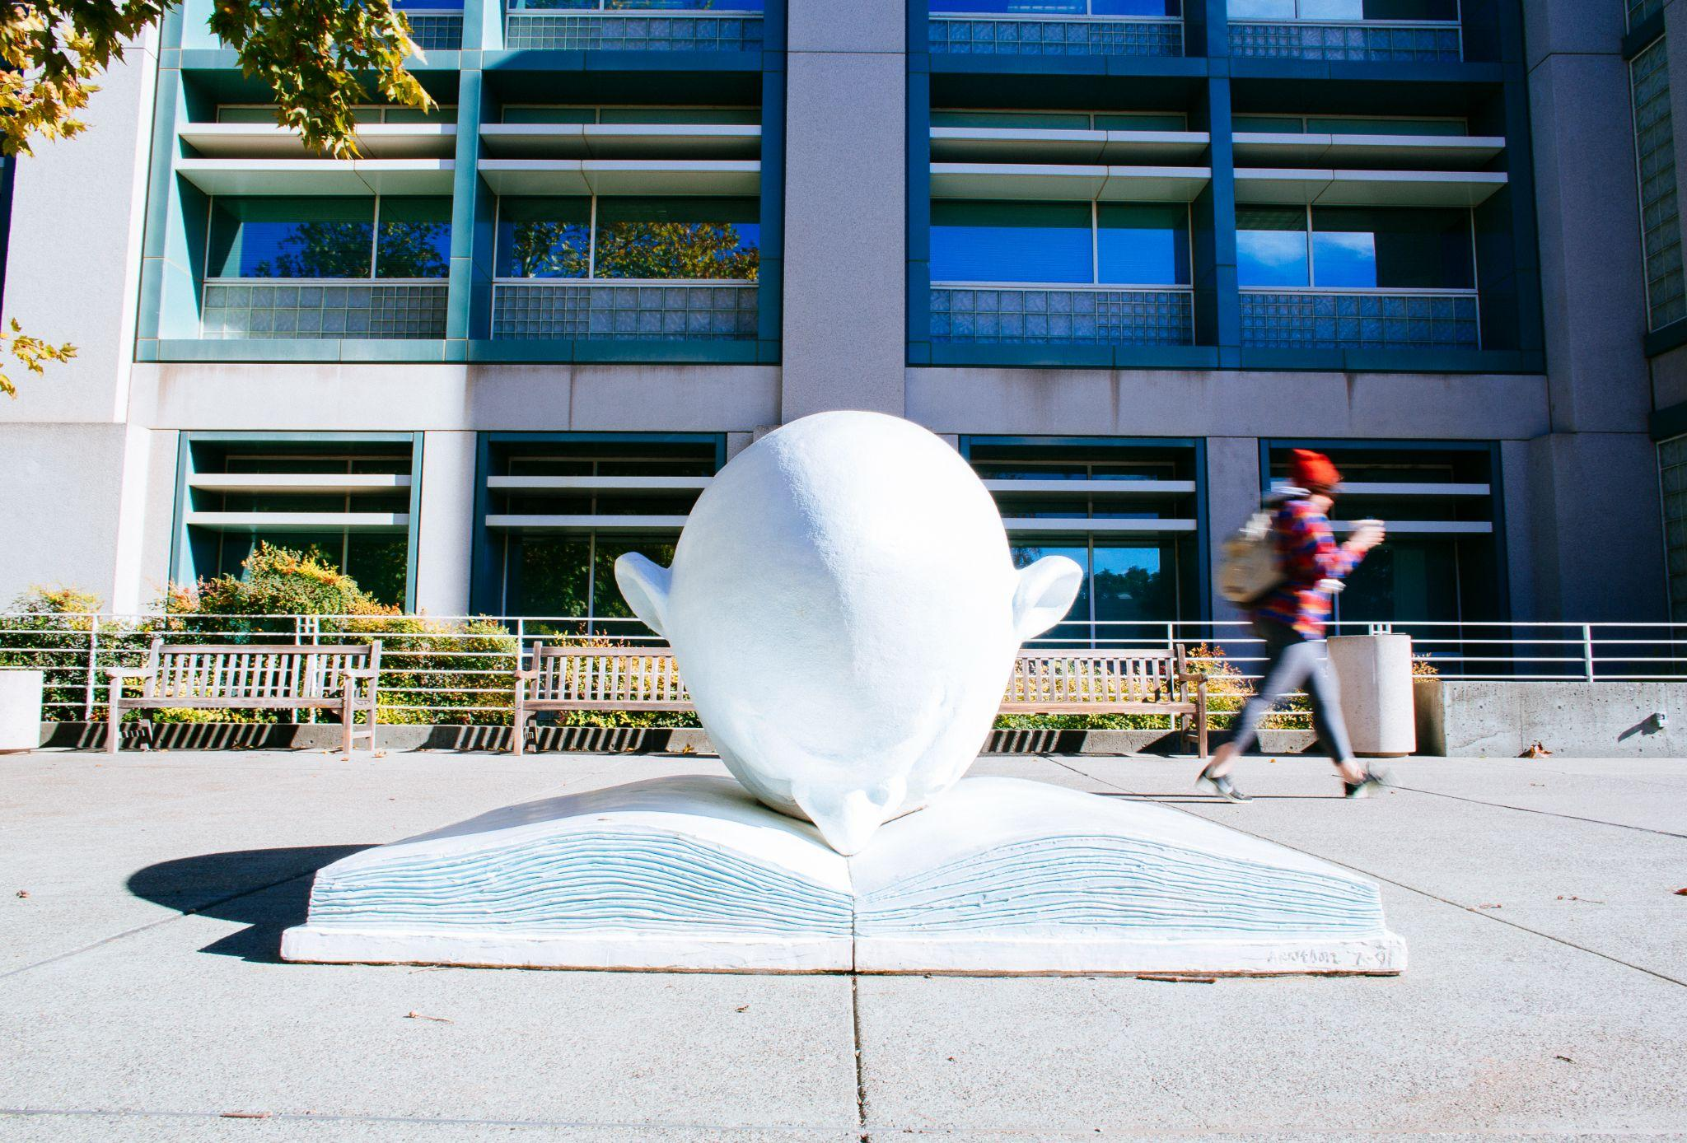
Journal Archiving Campaign Service (JACS) Refresher & JACS 10
UC Libraries Shared Print
August 14, 2025, 10-11am PT
Notes:
Alison

Slide 2
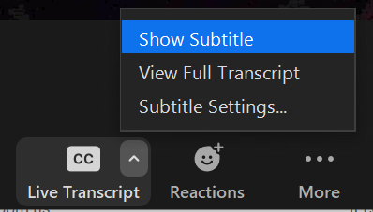
Housekeeping
Zoom transcript is enabled
This meeting is being recorded
Notes:
Alison

Slide 3
Journal Archiving Campaign Service (JACS) Refresher & JACS 10
UC Libraries Shared Print
August 14, 2025, 10-11am PT
Notes:
Alison

Slide 4

Today’s agenda
UC Libraries’ shared print strategy
What is JACS
JACS 10
What’s next in JACS?
Notes:
Alison

Slide 5
UC Libraries’ Shared Print Strategy
UC Libraries’ Vision
Agile, focused, efficient, and data-driven, the UC Libraries will be leaders in providing the broadest access to the world’s knowledge and in developing innovative services, strategies, and technological systems that promote discovery and preserve knowledge.
Notes:
Alison
https://libraries.universityofcalifornia.edu/about/vision-and-priorities/
Our Shared Print Strategy in UC Libraries is very much aligned with the overall UC Libraries’ Vision that focuses on providing the broadest access, promoting discovery, and preserving knowledge.
Print remains an essential part of meeting that vision.
Print gives us more avenues to provide access. There is a lot available electronically, but the growth rate and quality of digital resources can differ greatly across disciplines, as can the ongoing pedagogical needs for print copies to support research, teaching, and learning in certain disciplines. Further, ebooks and journals may abound, but libraries’ freedom to lend that digital content can often be more strictly controlled than lending digital copies from the print.
Print collections also have ongoing importance as complements to digital resources in order to to preserve and steward knowledge. Print retention supports our ability to validate the digital copy in the future, re-digitize if necessary, and and of course, digital formats have their own distinct fragility. Whether due to rapidly obsolescing technology or the ease in which digital access can be disrupted or taken away.
And the most sustainable way to ensure ongoing preservation of and access to print is to work together in UC and beyond. And that’s what we do with our shared print initiatives.

Slide 6



UC Libraries’ Shared Print Strategy
Protect scarce and unique content
The power of scale
National
More content, storage, and distribution
Regional
Local -
UC Libraries
Target local priorities
Highly developed, existing sharing relationships
Journal Archiving Campaign Service (JACS)
Notes:
We have a multilayered approach to our work in shared print. Not only are we engaged in UC Systemwide shared print collection building, but we leverage partnerships at the regional, national, and even international levels to extend our capacity and what we can provide users access to.
The Journal Archiving Campaign Service (JACS) is situated in our most local shared print efforts, which benefit from really robust resource sharing relationships as well as shared services and infrastructure like the SLF and our shipping services.

Slide 7
What is JACS
JACS is established to accelerate UC’s journal archiving work (in addition to the system’s participation in WEST)
Formation of journal shared print projects in UC (e.g. IEEE and UC JSTOR)
JACS 10 Consolidation & Transition Cycle
2011
2023
2005
2015
2025
Launch of WEST influence UC approaches to shared print journals
JACS Program Assessment Report & Recommendations
New Era for JACS
Notes:
JACS emerged from a long history of collaborative action for print collections by UC libraries
Here in 2025, JACS is reaching its 10 year mark of operations - it’s become a very mature and established set of workflows and expectations for compiling a shared collection in the SLF.
In 2023 we launched a comprehensive program assessment which is shaping how we’re moving into this 10th cycle of JACS and thinking about the future of the initiative.
—--------------
UC was an early leader in designing and carrying shared print projects - for example collaborating with JSTOR itself to establish a print archive at SLF-S to complement and support the digital collections - during that project to establish the JSTOR archive, UC first experimented with approach of sending multiple copies of a title to the what were then the RLFs in order to effectively create the most complete and best condition archived copy possible; around 2010 UC libraries were instrumental in founding the Western Regional Storage Trust as a means of expanding our capacity to maintain robust print journal collections
WEST helped us clarify some the complex details and expectations that makes a distributed collection trustworthy and dependable; technology
JACS Program Assessment Report: https://cdlib.org/wp-content/uploads/2024/01/Final-Report_JACS-Program-Assessment-2023.pdf
Every year there’s an opportunity to contribute to JACS; and next FY - FY2025-26, we doing a consolidation phase - everyone will have an opportunity to spend some reviewing the 8 previously title lists and sending more content for consolidation and preservation at the RLFs

Slide 8
What is JACS
The Shared Print Strategy Team and its Collection Working Group oversee analysis and selection of titles for coordinated deposit to the SLF
  High overlap & broad disciplinary coverage
  Title nominations from UC CKGs
Campuses are provided with an annual title list from which they can choose to send holdings for deduplication and archiving at the SLF
  Participation is voluntary and at the pace that works for each campus
  Campuses can send all holdings without deduplicating in advance
The SLF physically validate the archives and provide assured, ongoing access to the holdings across the system

Slide 9
Impact of JACS
3,342 journal families selected
112,878 volumes consolidated from the campuses
15,000+ linear feet of campus library space repurposed
$2.7 million cumulative campus cost avoidance
Notes:
As of the 2023 program assessment…

Slide 10
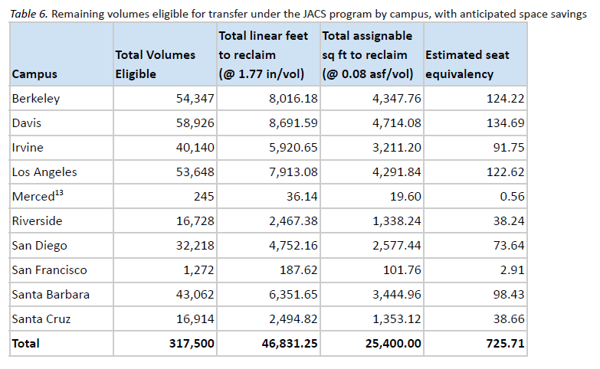
But there’s more!
47,000 linear feet in campus space can still be reclaimed as needed.
Which brings us to…

Slide 11
JACS 10 - Consolidation and Transition Cycle
To Campuses
An invitation to revisit JACS lists 1-9 to strategically consolidate more serial holdings at the SLF for systemwide retention and access, while repurposing local space.
For the Shared Print Strategy Team
An opportunity to:
target our approach for future JACS cycles as the universe of content becomes more distinct (less overlap)
Expand the JACS approach to new content areas (e.g. CA state documents)
Notes:
Why now? What’s changed?
UC is entering a new era with our shared collections space. In March 2025, the UC Libraries and UC Provost endorsed a philosophical, strategic, and operational shift from regional to systemwide library storage and access facilities. This shift emphasizes the Systemwide Library Facilities as fully shared, common good resources for all the UC campuses. Over the years in JACS, there has been some reluctance to deposit materials cross-regionally. We expect that the new ethos of the Systemwide Library Facilities will encourage more cross-regional deposit. Changing campus dynamics can also present new opportunities for participation.
Shifts in collection strategy and budget
Changes in physical space needs and strategy
Increased confidence in long-standing shared print partnerships and the power of collaboration to provide access to broad and deep collections

Slide 12
JACS 10 resources for campus participation
Consolidated titles lists & reports
  Campuses define their local review & decision processes
Information sharing - Shared Print Coordinators bimonthly meeting
  Compare notes; ask questions
Deduplicate locally or send all holdings to the SLF
  Note that duplicates will count against allocation
JACS shipping service
  Also open to other campus shipping needs
Notes:
JACS 10 Campus Resource: https://drive.google.com/file/d/1_TFb9Z7UlGEk0CUNB0MNRixU9yjURnAM/view
Shared Print Coordinators for JACS: https://cdlib.org/services/collections/sharedprint/jacs/campus-coordinators/
JACS Shipping Service: https://cdlib.org/services/collections/sharedprint/jacs/shipping/

Slide 13
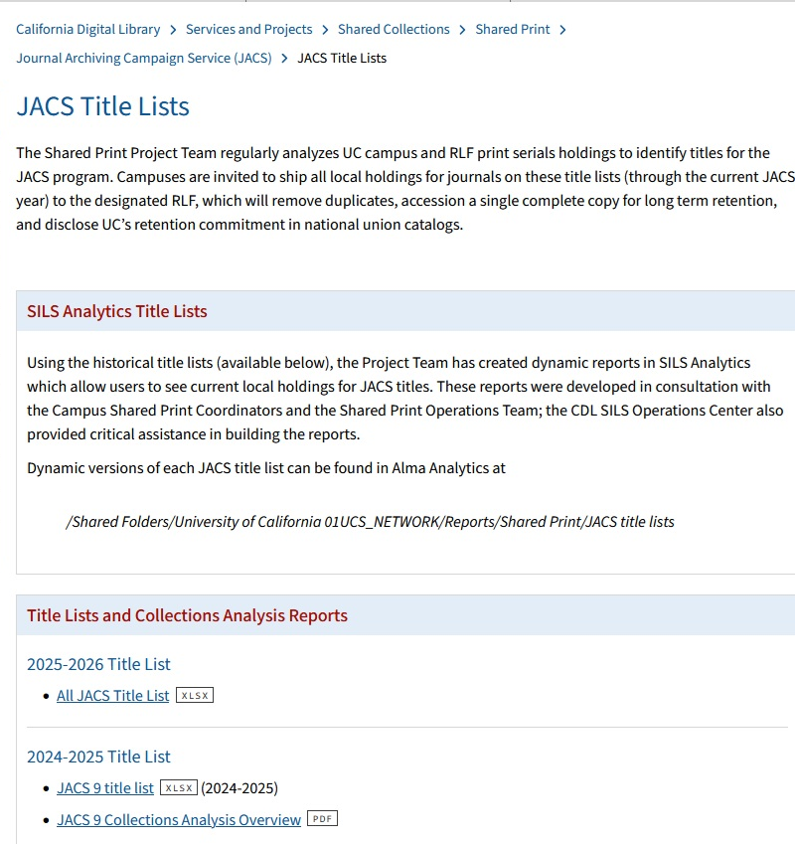
JACS Title Lists - Google Sheet
All JACS Title List
Available as .xlsx on JACS Title Lists page on website

Slide 14
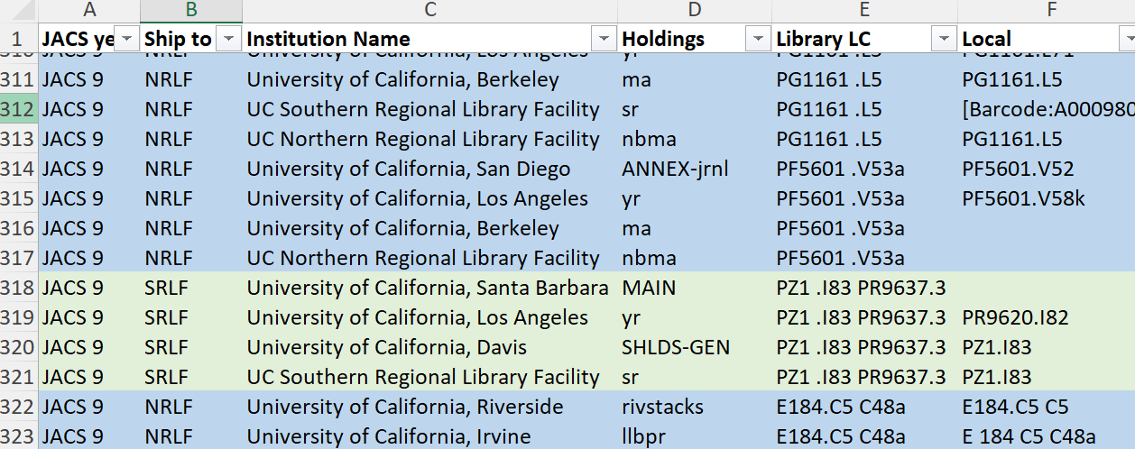
JACS Title Lists - Google Sheet (Demo)

Slide 15
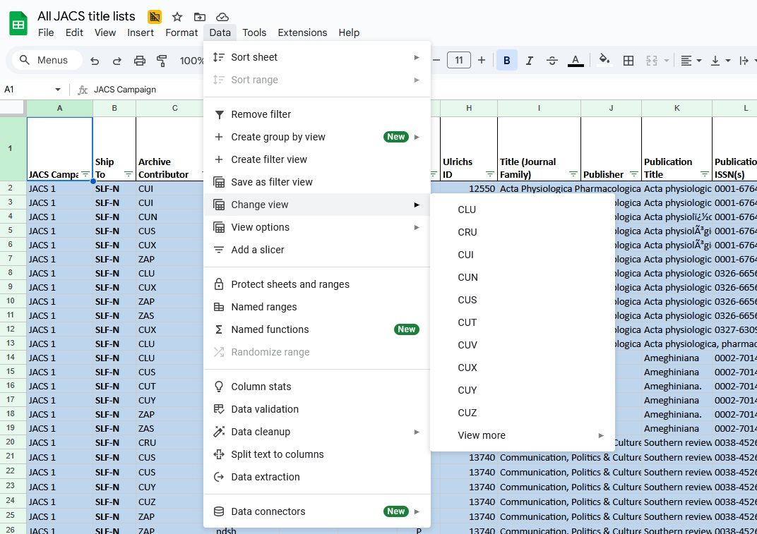
Viewing Your Campus Filter View

Slide 16
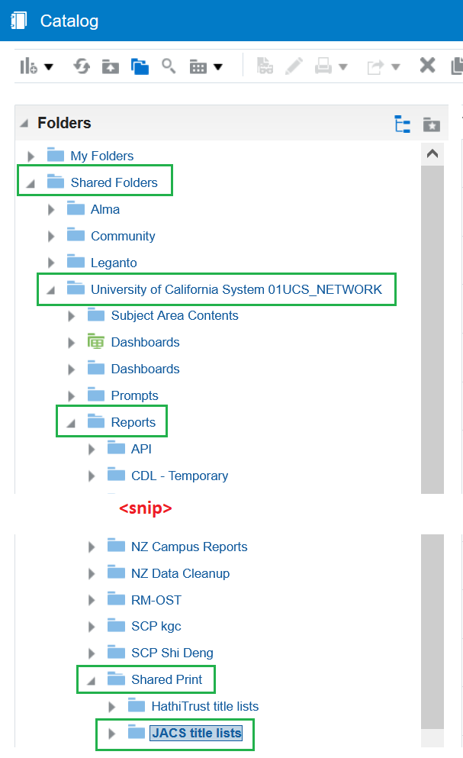
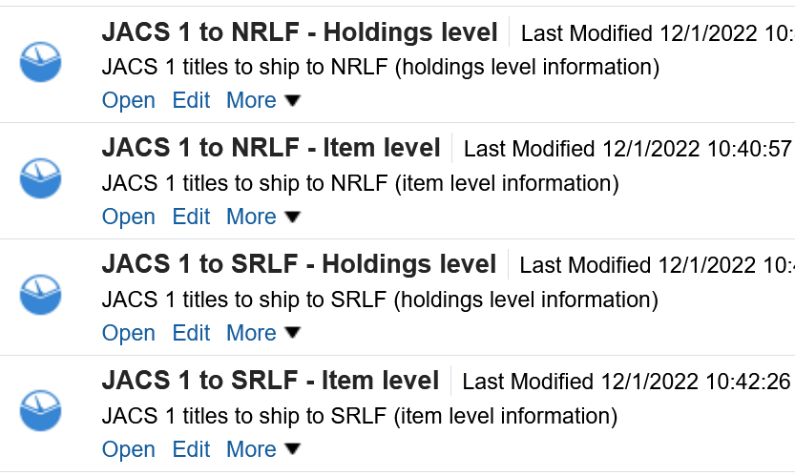
JACS Title Lists - Alma Analytics
Based on title lists
Separated by SLF
Holdings- and Item-level reports
Dynamic reporting of current IZ holdings data
  Limited to only your campus
Links to UC Library Search
Notes:
Nika
https://cdlib.org/services/collections/sharedprint/jacs/title-lists/
Now that we’re on SILS, we’ve begun recreating these title lists in Analytics. Using the original, authoritative JACS title list spreadsheets we’re building Analytics reports in the Network Zone which are accessible from the IZs through a shared folder (the path is shown on the screen here). When you open any of these, you’ll only see you own IZ’s holdings, current as of yesterday (like any Analytics report). There’s a lot of data that’s available in Analytics that just isn’t in AGUA. Plus, you can make a copy of any report at any time

Slide 17
What’s next for JACS?
JACS 11 and beyond…
New strategies for prioritizing lower overlap titles
Expansion of the JACS approach to new content areas

Slide 18

Thank you!
Questions?
Alison Wohlers, Assistant Director for Shared Print alison.wohlers@ucop.edu
Nika Burns Teshin, Shared Print Analyst nika.worth@ucop.edu
Notes:
Stop the recording for questions

