Slide 1
Journal Archiving Campaign Service (JACS)
Refresher
(and a bit of a teaser for the future)
June 6, 2024
Notes:
Alison <1 min
Welcome everyone and thank you for joining today’s webinar. I’m Alison Wohlers - the shared print program manager for UC Libraries. Today, we will be doing a refresher and a look to the future for the Journal Archiving Campaign Service (JACS), which is one of UC Libraries’ longstanding and most active shared print initiatives.

Slide 2
Agenda
Brief introduction to shared print
What is JACS?
How JACS works
Questions throughout!
Notes:
Alison <1 min
brief intro to shared print - what and why?
higher level look at what is jacs - where did it come from, what are the benefits, where is it headed
get into the specifics of the how - what does the data prep and analysis look like, what does campus library participation look like, what do the regional library facilities do?
throughout we’ll hear from a few folks who are directly involved in various pieces of the how

Slide 3
Who we hope to reach with this session
Collection strategists
Subject specialists and CKGs
Staff maintaining the physical collections
Public service staff
Circulation staff/frontline staff
Digital collections development staff
Notes:
Alison <1 min
This webinar is meant for a broad audience. We want shared print initiatives like JACS to be connected and resonating with a range of library services. This work absolutely has connections with access and conversations with patrons - what does access look like in a more distributed collection? We hope that the strategy of our shared print efforts can interconnect with our digital efforts and strategy. Of course some of the most explicit implications and opportunities are for local decision-making around collections and amongst subject specialists and staff maintaining the physical collections. So we hope everyone attending today, whether you are already familiar with the JACS initiative and shared print or just beginning to learn about them, can find something that connects to their work and feel welcome to ask questions and make observations.

Slide 4
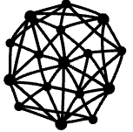
What is Shared Print?
A formal agreement
Assurance of continued access
Augmentation of local capacity
Notes:
Alison 1 min 30 sec
So what is shared print? Shared print can have a lot of permutations, but it often (and in the case of the programs UC generally participates in) is:
A formal agreement to specify responsibility for specific print or physical collections
Assurance of continued access to print resources across a network of institutions (which is unique from ILL and resource sharing agreements)
And as a result of these first two pieces - the formal agreement to preserve and the assurance access, shared print collections become a solution that augments local capacity for strategic collection management and development

Slide 5
Why Shared Print?
Library collections and services continue to grow. Physical space and other library resources are in demand.
Print is an essential part of vibrant local collections and the broader scholarly ecosystem.
More avenues to provide access
Print as a valuable complement to digital resources
Notes:
Alison 2 minutes
Library collections and services continue to grow. Libraries are constantly asked to stretch their resources further and to do more with what they have, including their physical space. There are a lot of challenges maintaining and managing print collections.
And yet print remains an essential part of library collections.
It gives us more avenues to provide access. There is a lot available electronically, but the growth rate and quality of digital resources can differ greatly across disciplines, as can the ongoing pedagogical needs for print copies to support research, teaching, and learning in certain disciplines. Further, ebooks and journals may abound, but libraries’ freedom to lend that digital content can often be more strictly controlled than lending digital copies from the print.
Print collections also have ongoing importance as complements to digital resources. Print retention supports our ability to validate the digital copy in the future, re-digitize if necessary, and protect against the fragility of digital formats, whether due to rapidly obsolescing technology or the ease in which digital access can be disrupted or taken away.
What is true across the board is that the preservation and ongoing availability of print resources is a fundamental component and value of library collections now and into the future. But no single library, regardless of whether they are an ARL or a small speciality library, can do this on their own.

Slide 6
Layers of Shared Print Strategy for UC
Situates local and regional efforts within a larger framework
National
Regional
More content, storage, and distribution
Local -
UC Libraries
Targets local priorities
Highly developed, existing sharing relationships
Notes:
Alison 2 min
We work in generally three layers of shared print in UC. Over time, these layers have become more interconnected.
Our aim at the local level - with our UC-specific initiatives and programs like JACS - is to really target localized priorities and leverage the highly developed sharing relationships we already have with one another.
At the regional level we can amplify our system wide work by plugging into a network with more content, more storage space, and more libraries to the share responsibility of the print corpus.
Our efforts at the national level are characterized by situating our local and regional intensive efforts within a larger framework of information and expertise sharing (e.g. aligning policies, advocating with service providers, seeing the bigger picture and identifying at-risk material).
So we have a layered ecosystem of strategies and opportunities for collaborating around our print collections

Slide 7
What is the Journal Archiving Campaign Service (JACS)?
Notes:
Alison

Slide 8
Journal Archiving Campaign Service (JACS)
identifies & selects
consolidates in secure storage
completes & preserves; and
provides ongoing access to…
UC print journal collections
Notes:
Alison
In a nutshell…

Slide 9
JACS Origins
UC JSTOR experiments with and refines a deduplication service
2005
~2011
2015
2025
Formation of journal shared print projects (e.g. UC JSTOR, IEEE)
WEST tools and structures incorporated into UC projects
Journal Archiving Campaign Service (JACS) program established
New era for JACS
Notes:
Alison
JACS emerged from a long history of collaborative action for print collections by UC libraries
UC was an early leader in designing and carrying shared print projects - for example collaborating with JSTOR itself to establish a print archive at SRLF to complement and support the digital collections - during that project to establish the JSTOR archive, UC first experimented with approach of sending multiple copies of a title to the RLFs in order to effectively create the most complete and best condition archived copy possible; around 2010 UC libraries were instrumental in founding the Western Regional Storage Trust as a means of expanding our capacity to maintain robust print journal collections
WEST helped us clarify some the complex details and expectations that makes a distributed collection trustworthy and dependable; working beyond uc helped us get really clear about the policies and expectations we needed to set to make this work
JACS Program Assessment Report: https://cdlib.org/wp-content/uploads/2024/01/Final-Report_JACS-Program-Assessment-2023.pdf

Slide 10
JACS Benefits
Responsible & Responsive Print Collection Stewardship
Collection building - creates a journal collection that draws together the strengths of all the UC campus libraries
Preservation - extends the lifetime of journal print collections through environmentally-regulated and secure housing
Access - enables easy access through document delivery
Notes:
Alison

Slide 11
Evolved over time -
JACS in the Shared Print Ecosystem
National
Adds intentional redundancy to the national shared print network
Adds more, unique titles to the regional shared print network
Regional
Local -
UC Libraries
JACS
Notes:
Alison
avoiding WEST duplication
leveraging the number of national copies to prioritize content

Slide 12
Evolved over time -
Changes in analysis and selection
Overarching, quantitative criteria and prioritize high overlap content
Curatorial nominations by subject matter experts
Notes:
Joseph
metrics driven, early days of JACS were very much about medium to high overlap content, especially those with online full-text purchased by CDL and to a lesser extent those with online indexing coverage, balance among humanities, social sciences and sciences were maintained until recent years.
over the last 5 years though, the JACS initiative has been gradually introducing more scarce/unique material and emphasizing the role of CKG title nominations more
since JACS is coming to the end of priority medium to high overlap content; we expend that role of subject matter expert nominations will expand as we look at the tail-end of print serial content across the UC campuses
https://cdlib.org/wp-content/uploads/2024/04/JACS-9-Collections-Analysis-Overview.pdf (see page 7)

Slide 13
FY24-25 - JACS 9 Title List is out!
Eligible for deposit to the RLFs via JACS starting July 1, 2024
459 journal families prioritizing
Opportunities for space reclamation at campuses
Holes in the shared print safety net
Subject area priorities
Notes:
Alison
Opportunity for space reclamation (4+ copies in UC)
Holes in the shared print safety net (2 or fewer retained by other shared print programs)
Subject area priorities (CKG nominations)

Slide 14
FY25-26 - What will JACS 10 look like?
A year for consolidation and transition
Fill gaps in the archived runs at the RLFs
Expand JACS to new content areas
Notes:
Alison
Opportunity to review previous JACS lists and catch up on contributing content
…California State Documents emerged as a high priority in the 2023 JACS Program assessment https://cdlib.org/wp-content/uploads/2024/01/Final-Report_JACS-Program-Assessment-2023.pdf

Slide 15
JACS - the big picture
JACS 9 list is posted for review and preparation
JACS 9 content is eligible for deposit to the RLFs
A new look for JACS…
April 30, 2024
July 1, 2024
July 1, 2026
June 6, 2024
July 1, 2025
JACS Refresher Webinar
JACS 10 - Consolidation & Transition Year
Notes:
Alison
Note that in the meantime folks can continue to send JACS 1-8
JACS 10 will be a unique “consolidation & transition cycle” to support:
Retrospective contribution and consolidation of remaining JACS campus content at the regional library facilities (Recommendation #4)
Investigation into expanding JACS to new content areas (Recommendation #5)
Deduplication pilot between the RLFs on the basis of JACS to maximize high density space (Recommendation #8)

Slide 16
Questions?

Slide 17
How JACS works (operates)
Notes:
Alison

Slide 18
JACS Data Prep, Analysis, & Selection
(1) Data ingest
(2) Data normalization & enhancement
(3) Analysis
(4) Selection
UC campuses prepare and submit serial and journal bibliographic and holdings data to be ingested into the AGUA tool
CDL teams normalize data and add fields for analysis and decision-making (e.g. presence in trusted digital repositories)
Overseen by the Shared Print Strategy Team (SPST)
Undertaken by the Collection Working Group (Subject Specialists and Collection Experts from SPST)
Based on criteria set by SPST and title nominations gathered from the Common Knowledge Groups (CKGs).
Annual title lists include ~20,000 volumes for archiving at the RLFs.
Notes:
~10 minutes for this subsection
Alison and Joseph
(Alison) We bring in data and analyze it every two years. We try to identify two-years’ worth of content for action. We do it this way because ingesting (and submitting on the part of the campuses) data is intensive - so we spread out that work and try to get as much actionable data out of each analysis as we can.
(1) Data ingest (Alison)
UC libraries’ data is pulled from the same bib and holdings data submitted for regional analysis with the Western Regional Storage Trust; UC uses a custom-built serial analysis tool called AGUA to manage and analyze the data
(2) Data normalization & enhancement (Alison)
The CDL team process the bib and holdings data so we can more easily compare holdings and assess the relative priority of content. We combine campus data with a fair number of other data sets like the Ulrich’s Periodical Directory; digital repository titles lists like Portico, CLOCKSS, JSTOR, HTDL; commercial database title lists; and what’s been retained by other shared print programs across the US and Canada. We also do some custom data field generation for example comparing the local holdings to published holdings recorded in the bib record to get calculations on completeness; we generate counts of holdings from OCLC comparison. So in the end it’s a pretty detailed and powerful data set we can then analyze.
(3) Analysis (Joseph)
The Shared Print Strategy Team provides high level criteria to a subset of the Team - the Collections Working Group or CWG - to start off the analysis
The CWG includes the CDL shared print analyst and experts from broad subject areas, including: sciences, social sciences, and humanities; the SPST Collection AULs and Collections Strategists can also choose to join the CWG in any given analysis
The Shared Print Analyst uses that high level criteria to create scenarios for the CWG to review and refine
The CWG selects which scenarios to develop further and sends out a call to the UC CKGs to invite title nominations
(4) Selection (Joseph)
Using the criteria initially set by SPST, the group’s refining expertise, and nominations from the CKGs, the CWG finalizes a list of journal families to prioritize for the next two-years’ work of archiving (consolidation at the RLFs)
The proposed list is submitted for approval to SPST and is then posted to the CDL Shared Print website along with a report on the analysis process and findings

Slide 19
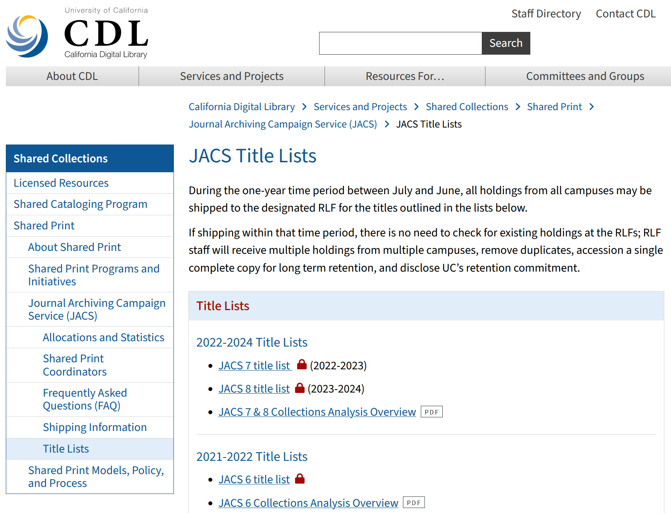
JACS Title Lists
Authoritative lists of titles eligible for JACS
All holdings from all campuses included
Accessible to any UC user through CDLib Shared Print website
Static and unchanging
Notes:
Alison
https://cdlib.org/services/collections/sharedprint/jacs/title-lists/
One of the distinctive things about the JACS initiative is that we’re not designating a specific library’s holdings as the ‘the archived copy’ but assigning titles to one of the RLFs and then inviting all the UC campus libraries to help build the archive. So the title lists include holdings from across the system.
This is a screenshot of the CDLib page where all the JACS title lists reside. Campuses are always welcome to go back to past titles lists. But, as we’ll note in a minute, we also have an alternative and more up to date resource for looking at past JACS title lists and what you can contribute now.

Slide 20
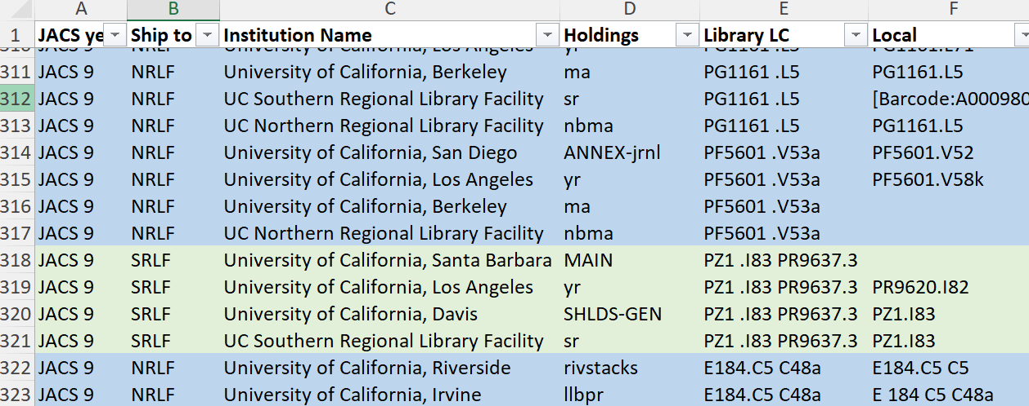
JACS Title Lists
Notes:
Alison
This is a screenshot of the what you’ll see when you open up a title list from the website.

Slide 21
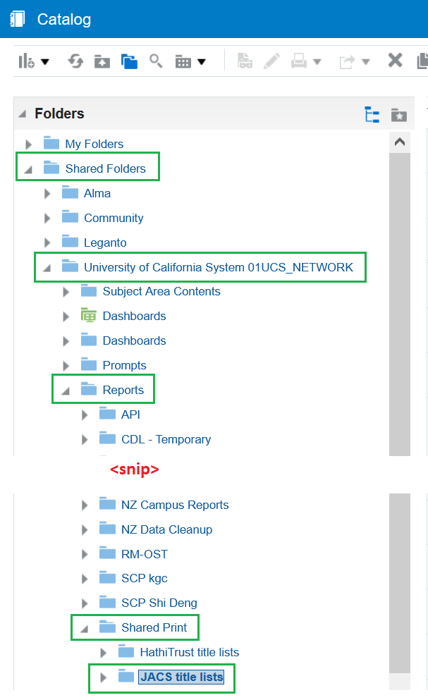
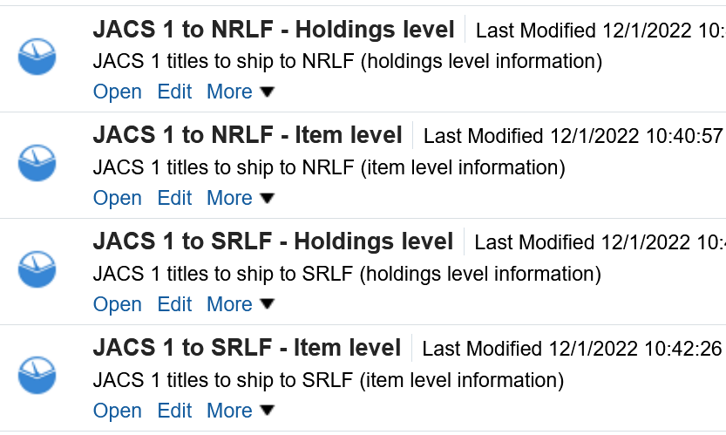
JACS Title Lists - Alma Analytics
Based on title lists
Separated by RLF
Holdings- and Item-level reports
Dynamic reporting of current IZ holdings data
Limited to only your campus
Links to UC Library Search
Notes:
Alison
https://cdlib.org/services/collections/sharedprint/jacs/title-lists/
Now that we’re on SILS, we’ve begun recreating these title lists in Analytics. Using the original, authoritative JACS title list spreadsheets we’re building Analytics reports in the Network Zone which are accessible from the IZs through a shared folder (the path is shown on the screen here). When you open any of these, you’ll only see you own IZ’s holdings, current as of yesterday (like any Analytics report). There’s a lot of data that’s available in Analytics that just isn’t in AGUA. Plus, you can make a copy of any report at any time

Slide 22
Questions?

Slide 23
Campus review, selection, and shipping
Participation in JACS is voluntary
Each campus defines its own review & selection process
CDL provides a shipping service for JACS content
Edit/delete local holdings records
Notes:
~10-15 minutes for this subsection
Alison, Mark
Shared Print Coordinators for JACS: https://cdlib.org/services/collections/sharedprint/jacs/campus-coordinators/
JACS Shipping Service: https://cdlib.org/services/collections/sharedprint/jacs/shipping/

Slide 24
Questions?

Slide 25
RLF processing
Preparing RLF holdings to receive JACS
Volume-level validation
Accessioning a single, consolidated backfile
Removing & recycling duplicates
Disclosure in OCLC
Reports of volumes accessioned/volumes discarded per campus
Notes:
Tim Converse (Operations Manager) and Tin Tran (Processing Manager)

Slide 26
Questions?
Notes:
Tim Converse and Tin Tran

Slide 27
Final Reminders!
The JACS 9 title list is available for your review
Deposit to the RLFs for JACS 9 begins July 1, 2024
JACS 1-8 are eligible for deposit at any time
JACS 10 (FY 25-26) is a dedicated opportunity to review past lists
Notes:
Alison

Slide 28
Questions? Would you like to get involved? CDL Shared Print Manager Alison Wohlers Email: alison.wohlers@ucop.edu

