Slide 1
Introducing the New AGUA Interface
Using Collection Comparison Reports and Registering Archiving Commitments
September 2020
Notes:
Thanks everyone for taking the time to join this webinar introducing the new AGUA interface! We’re very excited about the updates and to be able to share them with you.

Slide 2
Sound & Visual Check
Can you hear the presenter?
(please note any audio issues in the chat)
Notes:
Before we get started I want to make sure the technology is working--can everyone see the screen? Everyone’s muted, but you can either unmute yourself to let me know if you can’t see the screen, or put a comment in the chat. Can you hear the presenter? Also as a reminder we are going to be recording this presentation to distribute to anyone who wasn’t able to make it today.

Slide 3
Agenda
Introducing the new AGUA UI
Project overview
User Management
Finding Contact Information
Collection Comparison Reports
Reviewing Archiving Proposals and Registering Commitments
Archive Builder Budget Review
Notes:
The roadmap for this presentation is to first show you the updated dashboard and show you where to find pages for user management and contact information which all AGUA users have access to, then show you how to find your collection comparison reports and give a brief overview of what’s included in those. After that, we’ll go over how Archiving institutions can review their Cycles 10/11 archiving proposals and register archiving commitments in the new interface. Anyone who doesn’t do that work is free to leave at that point, but is also of course more than welcome to stay on the call to see how that process works.

Slide 4
Introducing the new AGUA UI
Notes:
One of the really valuable parts of WEST and AGUA is that we engage in regular system development to enhance features and develop new tools. However, the interface hasn’t undergone any major updates, with new capabilities just getting added to lists of links on the home screen, so we really wanted to give this an overhaul to make it easier to use. To that end, over the summer the AGUA technical team partnered with the CDL User Experience team to thoroughly review all of the AGUA pages and develop a new design that’s more user friendly and is web accessible.

Slide 5
Project Team
AGUA Technical Team
Lucy Liu - Programmer Analyst
Jing Jiang - Programmer Analyst
Judy Dobry - Technical Team Manager
Alison Wohlers - WEST Program Manager
Anna Striker - WEST Collections Analyst
CDL User Experience Team
Rachael Hu - User Experience Design Manager
John Kratz - User Experience Designer
Notes:
The project team did a remarkable amount of work on this, and I want to take the time to thank them and commend them on an amazing job.

Slide 6
User Design Philosophy & Goals
Design for members first
As simple as possible, but no simpler
Keep all functionality intact
Let the important stuff float to the top
Cut redundancy
Accessible and responsive from the start
Notes:
Before I show you the updates, I want to hand the mic over to my colleague John Kratz, User Experience Designer at the California Digital Library, who was instrumental in developing the designs to talk a little about the philosophy and goals of the new design.

Slide 7
Notes:
To kick us off, here’s what the interface looked like for many years. As we go through the presentation I’ll come back to this image to compare the layout you’re used to to the updated interface.

Slide 8
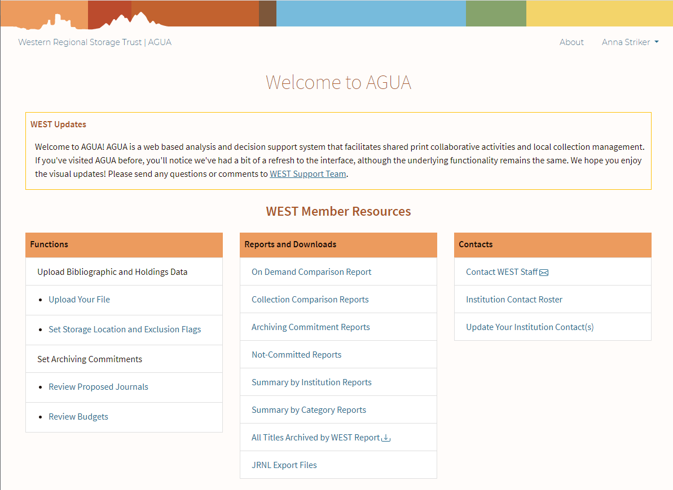
Notes:
The design has been updated to modernize the look and feel of the site and to make content easier to read. The new design retains all of the functionalities, but unpacks everything to give it a more comfortable feel. Additionally, all designs were developed and implemented to adhere to current web accessibility standards. No features were changed during this refresh, just the designs and layout.
Please note that not all of the links displayed above will be visible to everyone; some are only visible to users with specific roles assigned to their accounts.
There are three main sections on the homepage dashboard, with a fourth area for user account management:
Functions. This section includes pages for uploading files (which we ask you to do during the unarchived holdings ingest for the biennial collections analysis, and for disclosures at the end of each archiving year) and reviewing unarchived holdings locations ahead of the collections analysis. It also includes links for reviewing archiving proposals and making commitment selections. Builders will also see a budget review page here.
Reports and Downloads. This section includes all of the different reports that WEST makes available to members, including the On Demand Comparison Reports, yearly collection comparison reports, archiving commitment reports for Archive Holders and Builders, and many more. Archivers will also find their JRNL export files in this section.
Contacts. This section includes a link to contact WEST program staff plus a link to the Institution Contact Roster, which lists contacts and other information for each WEST member institution.
Additionally, user account management functions have moved out of the main dashboard and under your user name, which is displayed on every page.

Slide 9
Notes:
As you can see, AGUA has a lot of functions available, but for this presentation I want to highlight the user management pages as well as the specific pages that support the current activities that you’re working on at this point in the archiving cycle.
We’ll start with user management and contact information
Then move to the collection comparison reports
And finally to the pages where Archivers can review archiving proposals and record commitments

Slide 10
User Management & Finding Contact Information

Slide 11
Notes:
In the old interface, all user management functions, including account management and finding contacts at other member institutions, were available in the center section, as shown here. We’ve broken these apart a little bit in the new design.

Slide 12
Notes:
Now, when you’re signed in, you’ll see your name with a small arrow next to it in the top right corner of each page. User account management links are contained here.

Slide 13
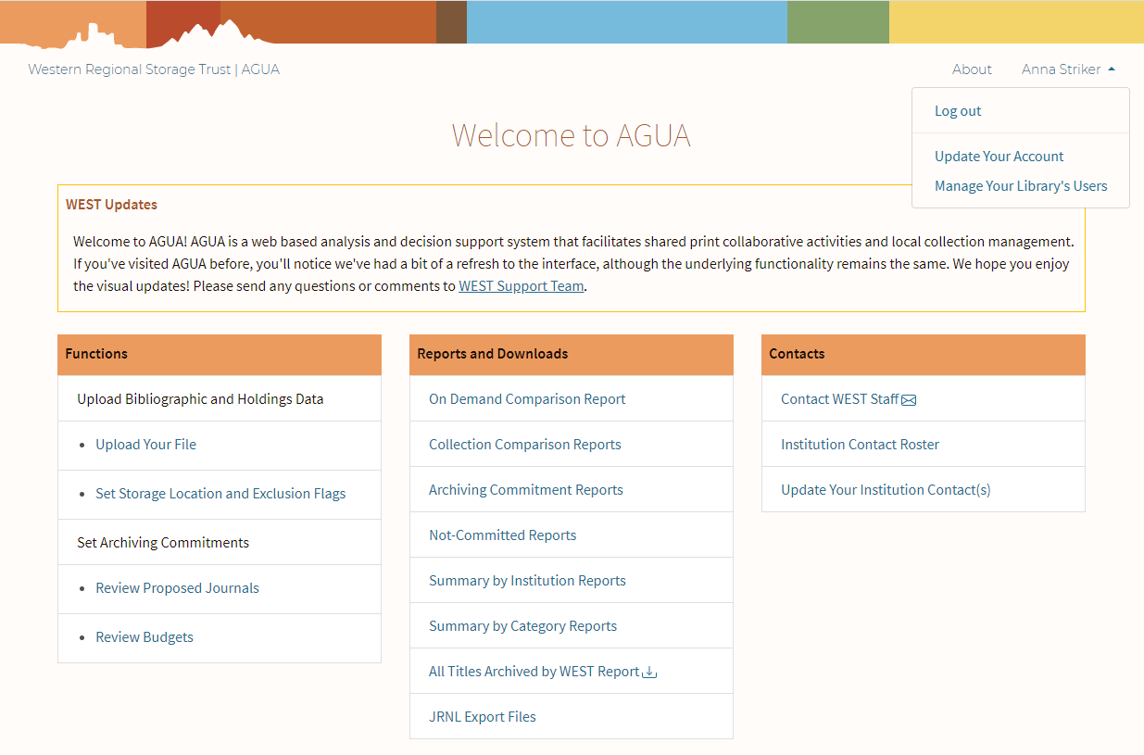
Notes:
Every user will see the “Update your account” option, where you can update some information in your account as necessary. Users that are designated as Campus Admins (one of the user roles available) will also see an option to Manage Your Library’s Users, where they can update contact information and also assign or remove permissions for other users in their institution.

Slide 14
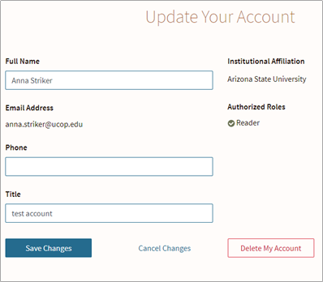
Notes:
Users will be able to update their name, phone number, and title, and view their email address, institutional affiliation, and the Authorized Roles granted to them (the user won’t be able to update any of these). Campus Admins will be able to access a list of their institution’s users and what roles they’re been granted under the “Update Your Library’s Users” link in that dropdown menu, and from there can open and edit each user account--it will look exactly like this, but you’ll also be able to change the Authorized Roles to add or remove permissions. Users may also delete their accounts, and Campus Admins may delete any accounts affiliated with their institution.

Slide 15
Notes:
If you want to see contact information for all of the WEST members, use the Institution Contact Roster. This roster includes brief information about each institution as well as any contacts that members have designated (this is what populates the contact information that’s included in the archiving and on demand reports).

Slide 16
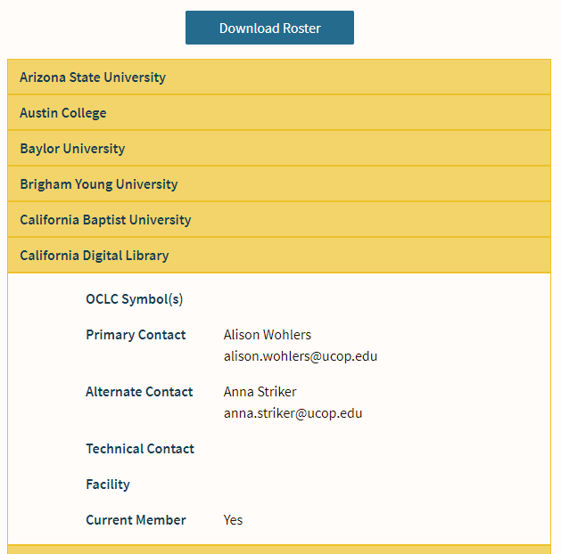
Notes:
The new Institution Contact Roster is a list of institutions, each opening a drawer when you click on it to reveal information for that particular institution. The previous version of the roster was a very large table that could be pretty overwhelming, so this design really helps the user focus in on a single institution by isolating them in drawers and displaying them one at a time. If you do want to see all contact information at once that option is still available to you: just use the Download Roster button at the top of the page to download an Excel file of the full roster.

Slide 17
Notes:
Campus Admins will also see an option to Update Your Institution Contact(s), where they can update who appears in the Institution Contact Roster and is listed in the archiving and on demand reports.

Slide 18
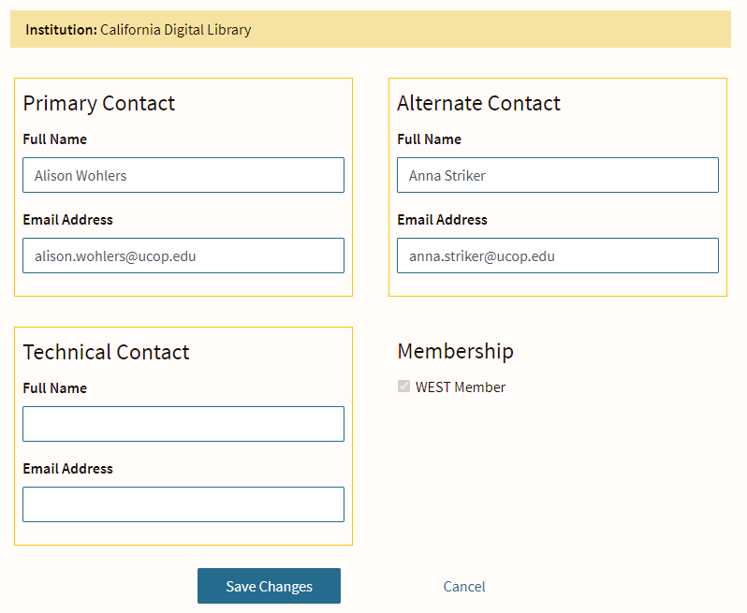
Notes:
Campus Admins can designate up to three contacts for their institution: a Primary Contact who’s the main point of contact for archiving activities (like calls for holdings or gap filling), an Alternate Contact who serves as a backup for the Primary, and a Technical Contact. Campus Admins are highly encouraged to check this periodically to make sure these contacts are up to date.

Slide 19
Questions?
Notes:
Let me stop here and see there are any questions about any of the user management functions, or about the design so far.

Slide 20
Collection Comparison Reports
Notes:
Now we’re going to move away from the administrative functions and get into some of the collections support that’s available from WEST. Each year after the disclosure period WEST generates collection comparison reports for members who submitted unarchived holdings files for the most recent collections analysis. This year’s reports are based on a comparison of the unarchived holdings files that were submitted in fall 2019 with all retention disclosures that have been submitted from the beginning of WEST through summer 2020. AGUA also has an On Demand Comparison report available that can be used at any time to compare locally-held titles against the WEST archives.

Slide 21
Notes:
For reference, these are where the reports lived in the old interface.

Slide 22
Notes:
And this is where you can find them in the new interface, in the middle “Reports and Downloads” section. I’ll start by talking about the Collection Comparison reports, and then we’ll briefly look at the On Demand Comparison tool.

Slide 23
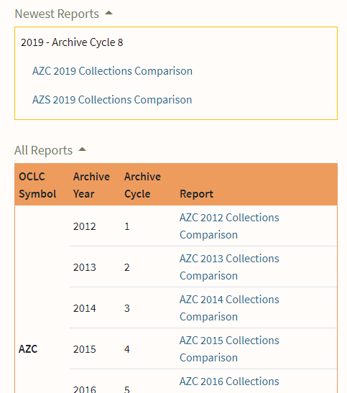
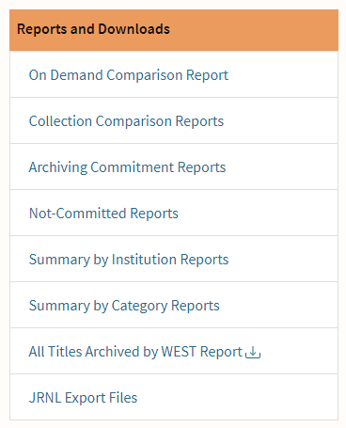
Notes:
You can find the comparison reports under the Collection Comparison Reports link in the middle column on the AGUA home page dashboard. All AGUA users have access to this space.
The new design highlights the newest reports while still keeping historical reports available all in the same place. When you open that page you’ll see a box with your institution’s most recent report(s) at the top, with a list of all comparison reports that have been compiled over the years listed below for reference. If your institution submitted unarchived holdings for multiple OCLC symbols, reports for both will be available on this page.

Slide 24
Information in comparison reports
Local holdings information:
Archived holdings information:
Notes:
The contents of the reports includes both local information gleaned from the unarchived holdings files as well as information about the archived copies, pulled from the retention disclosures that are submitted to WEST each summer.
These reports show you what you hold in your collection that’s already been archived in WEST can be used for a variety of local serials review projects. There are a few different ways you might use this information:
To help complete the WEST archives (and clear some space on your shelves), you might use this report to facilitate contributing parts of your holdings to filling gaps in retained titles held by other WEST members.
Or, you might use the report to conduct a more extensive de-duplication and deselection of your holdings based on what is retained in the WEST archive. Both these scenarios present significant opportunities for shelf-clearing and re-allocating space.
And even if you aren’t necessarily at the point of engaging in immediate shelf-clearing projects, you can use this report to scope how many of your journal titles have retention commitments in the WEST archive. This knowledge could proactively inform plans around space needs or collection management.
We include extensive location information in the reports to help support your on-site projects and make it easy for you to find the records in your local system as well as find the physical materials in your stacks. We also include contact information for the archiving institution for each title so you can quickly identify who to reach out to if you want to contribute volumes to fill in gaps or extend runs.

Slide 25
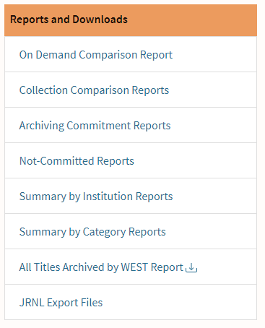
On Demand Comparison Report
Notes:
All members also have access to the On Demand Comparison Report tool, which allows you to upload a file of identifiers and have information returned about what titles have been archived within WEST as well as in the wider shared print community, and which titles have not been archived by anyone yet. Full instructions for using it (including input file requirements and what output files you might expect) are available in the appendix of the AGUA User Manual, but the short version is that to use the On Demand Comparison report, prepare a file of the journals that you want to check, including OCLC and/or ISSN for each (each row must include either an OCLC number or an ISSN for AGUA to make the comparison). You also have the option of including up to four other fields that will be returned on the reports that you receive back. These can be whatever you want, but examples of what you might include here are your local holdings location, call number if you use them for serials, your holdings statement, and your local system number. Once you’ve finished preparing your file, save it to your local device and then use the file uploader found on the On Demand Comparison report page to upload it. AGUA will automatically return the results of its comparison, which will be available in your Downloads folder on your computer. Again, this is a very brief description of how to use this tool, so please review the AGUA User Manual appendix for full instructions and to see examples of the output files that you can expect.

Slide 26
Questions?

Slide 27
Reviewing and Registering Commitments
Notes:
This section of the presentation will cover reviewing archiving proposals and registering archiving commitments for Cycles 10/11. This activity is only undertaken by Archive Holders and Builders, so while everyone is welcome to stay and learn more about this process it will be most relevant to those at archiving institutions.

Slide 28
Notes:
For reference, these are where the pages we’ll be covering lived in the old interface.

Slide 29
Notes:
And here’s where you can find them in the new interface. The “review” pages are under “Functions,” since there are pages where you have to take action for the current cycle, and the final commitment reports will be stored under the “Reports and Downloads” header (this page includes links to all historical archiving commitment reports, not just the current cycle).

Slide 30
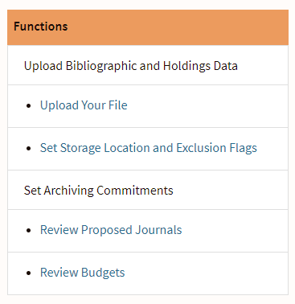
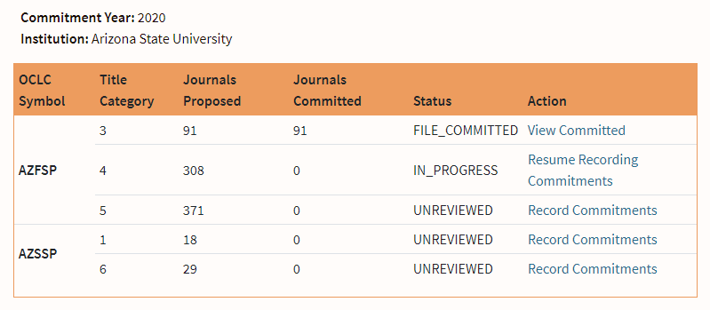
Notes:
First we’ll look at the changes to the Review Proposed Journals page. Like I mentioned, this link can be found under the “Functions” header, and is visible to any user with Holder or Builder permissions (which can be granted by your Campus Admin or by WEST staff). When you click on this link you’ll be taken to a page that lists the title categories available for review. This example uses Arizona State University, and since they’re a Builder you’ll can see all of the title categories they’ll need to review and make selections for. This page includes a brief summary of what’s included in each title category (the number of journals being proposed and the number of journals that have been committed), where the institution is in the review process for each title category (unreviewed, in progress, or “file committed”), and what actions can be taken on each. The Action column contains clickable links, which will take you to the next page. This new design really clarifies where you are in the process and what your next steps are, and helps highlight where to go next to take action on the proposals.

Slide 31
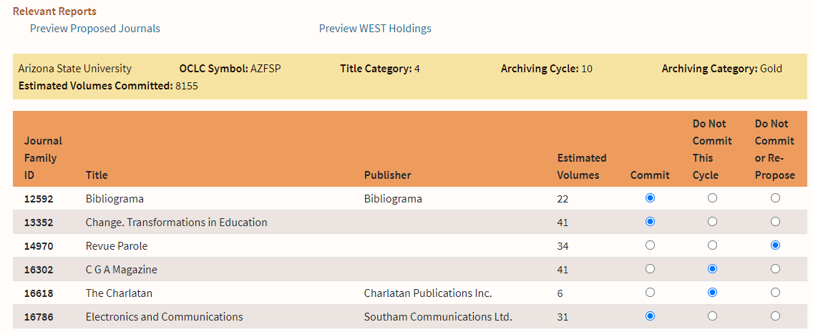
Notes:
When you land on the review page you’ll have a lot of information and actions available, so let’s walk through them one by one. The first thing I want to point out are the Relevant Reports that are linked above the selection area. There are two reports linked here for each title category:
The “Preview Proposed Journals” report only includes your local holdings information for the journals that are being proposed to you for that title category (as taken from the files you submitted to AGUA last fall). This report includes both bibliographic and local holdings information.
The “Preview WEST Holdings” report includes information from other WEST member institutions about their holdings for the journals that are being proposed to you. This is especially helpful for gap filling and completing journal backfiles (both of which are required activities for Title Categories 3, 4, and 5, which are archived by the WEST Builder institutions).
Below the Relevant Reports is information about the title category that you’re currently reviewing, including the OCLC symbol those journals should be archived under, the title category, archiving cycle, and archiving category. Also included in this section is a dynamic count of the estimated volumes that are being committed based on your current selections: this number will update automatically as you make your commitment selections below.
The bulk of the page is dedicated to listing the journal families that are being proposed to you for archiving during Cycles 10/11. This page only lists the journal families that are being proposed to you: the “Preview Proposed Journals” report lists out all of the individual titles that are being proposed. After you’ve completed your review and made your decision, you’ll indicate on this page whether you “Commit” to archiving the journal family, or whether you do not want to commit to archiving it to this cycle (but are open to archiving it in the future), or if you do not want to commit to it in this cycle and don’t want to have the journal proposed again in the future archiving cycle. To put it simply, your options are to 1) archive the journal now, 2) not archive the journal now but possibly archive it in the future, or 3) not archive the journal now and not archive it in the future. The default value is “Commit.”
When you’re finished reviewing the proposals and making your selections, use the “Submit” button at the bottom of the page to confirm and finalize these selections. If you need more time to work on your selections use the “Save and Quit” button to save your progress and come back later to work on it more. The “Cancel” button will take you back to the previous page without saving any changes from the current session. If you’ve done some work on this but want to reset your selections, use the “Reset Form” button to take all of the journals back to their default state of Commit.

Slide 32
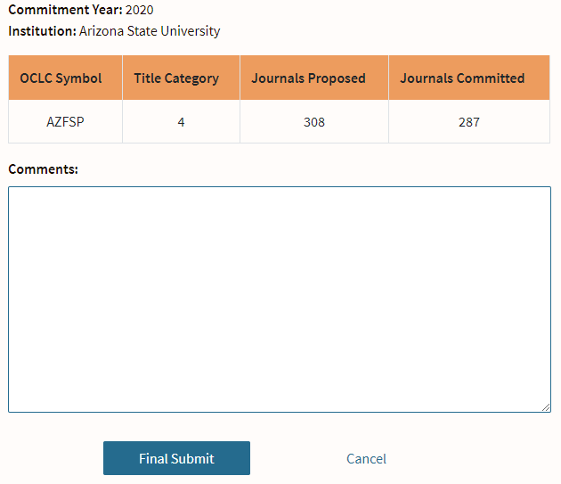
Notes:
After you’ve made all of your selections and click the Submit button, you’ll be taken to a confirmation page before you do the final submit for that title category. You’ll be given some brief information to review and you’ll have the opportunity to add any comments that you think are necessary or helpful. When you’re finished, click the “Final Submit” button.

Slide 33
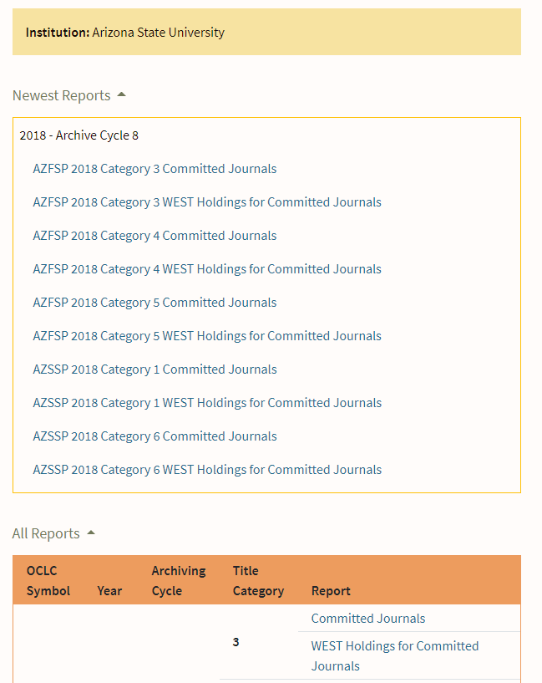
Notes:
After you’re made your final submission, AGUA will generate new Archiving Commitment reports for you, which will be available the next day in the Archiving Commitment Reports section. This link is found in the Reports and Downloads section of the dashboard.
As with the collection comparison reports page, this page highlights newest reports by gathering them in a box at the top, and then lists all historical and current reports below. These reports are separated by title category; for each title category you’ll receive one report listing your local information about the journals you committed to, and one report listing holdings from other WEST members for those journals you committed to. As a note, these sections are collapsible: click on the “newest reports” heading to collapse that section for easier navigation.

Slide 34
Questions?
Notes:
Before moving on to one additional step that Builders need to take before making their final submissions, I want to pause and see if there are any questions about the proposal review and commitment process.

Slide 35
ADDITIONAL STEP FOR ARCHIVE BUILDERS!
Notes:
The Archive Builder institutions are those which archive Silver and Gold journals on behalf of WEST, which require additional validation activities before they are considered to be part of the collection. To support these activities, WEST provides a per-volume subsidy, with each Builder institution having a set budget available to them based on their local capacity. As Builders make their selections for title categories 3, 4, and 5, they should periodically save their progress and come back to the AGUA dashboard to use the Review Budgets page to check how much of their subsidy they’ve used.

Slide 36
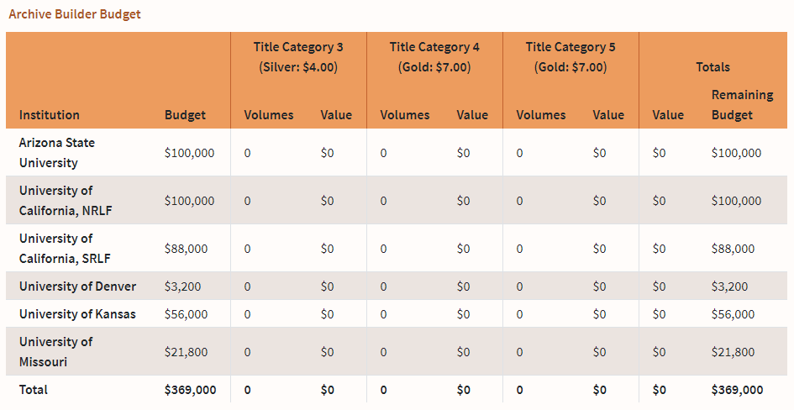
Notes:
This page will calculate the subsidy based on your saved progress. You DO NOT need to submit your selections for this page to update: instead, use the “Save and Quit” button on the review proposals page, then come here to check how much of your budget is remaining. Make sure you do a final review after you’ve finished your selections for all title categories!

Slide 37
Questions?

Slide 38
THANK YOU!
Contact us:
Alison Wohlers, WEST Program Manager
alison.wohlers@ucop.edu
Anna Striker, WEST Collections Analyst
anna.striker@ucop.edu

