Slide 1
WEST Members Meeting
ALA Midwinter2016
Boston, MA

Slide 2
WEST Program Update
Introductions
WEST Program Update
Archiving Progress and Collections Analysis Update
Systems Development Update
Your questions?

Slide 3
II. WEST: Program Update
Key Features of WEST
Distributed print journal archiving program
Membership-driven organization, 72 member libraries, shared governance
Retention period 25 years (to 2035), titles selected within risk categories, based on e-availability, digital preservation status
Archives held in multiple storage facilities and libraries; active archive creation of print only titles at 6 Archive Builder locations
Key Benefits
Access, Preservation and Space reclamation
Collections: Most STEM, Portico, CLOCKSS, JSTOR titles, many A&I and print only titles
Routinized collections analysis and distributed archiving decisions
Opportunities to participate: Archive Holder or gap filling

Slide 4
Where we are, where we’re going
Implementation
2011-2013
Sustainability
2014-2016
Future
2017-
3 archive cycles
Establish program
Mellon/Member supported
2 archive cycles
System enhancements
Program assessment P1&P2
Strategic Planning for sustainability
Mellon/Member supported
Ongoing archive cycles
Bi-ennial collections analyses
Fully member supported
Program adjustments
Keep doing what we do well

Slide 5
WEST Membership Update
Revised membership model
  Member types (full and supporter) with serviced better tailored to fit needs
  Fee tiers based on total library budgets
Gradually raising fees to replace grant funding
Program adjustments to reduce costs
  ingest for collections analysis
  archive creation subsidies

Slide 6
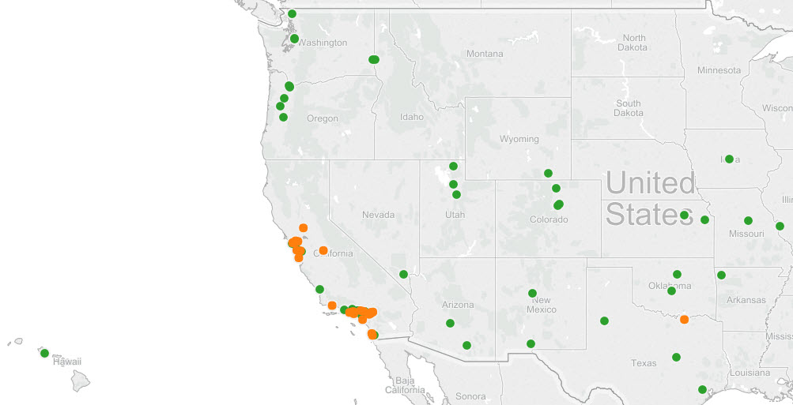
WEST Members
73 libraries in 18 states
New members
  Colorado State University, Fort Collins
  4 returning Orbis Cascade Alliance
Terminating members
  Orbis Cascade Alliance consortial members
  SCELC members
• Direct Member
• Consortium Member

Slide 7
Future Activities (2016/2017)
Program assessment phases 1 and 2
Disclosure Archive Cycle 5
Collections Analysis for Archive Cycles 6 and 7
Continue new member conversations
New service explorations
  Greater coordination with other print archives (Rosemont or “Thinking Bigger” group)
  Digitization and publisher outreach for Gold print only titles (WEST- JSTOR)
  Quality assurance services (Disclosure in OCLC and PAPR, Bronze “in place” holdings)

Slide 8
Q&A

Slide 9
III. WEST Archiving Progress as of January 2016
 |  | Bronze |  | Silver and Gold |  | Notes
 | Cycle | Volumes Budgeted in Grant | Volumes to Date | Volumes Budgeted in Grant | Volumes to Date
Phase 1 Implementation Phase | 1 | 3-year total: 117,000 | 125,416 | 30,000 | 38,116 | Cycle Complete
 | 2 |  | 47,873 | 52,000 | 48,401 | Cycle Complete
 | 3 |  | 40,123 | 60,000 | 53,903 | Cycle Complete
 | Total | 117,000 | 213,412 | 142,000 | 140,420
Phase 2 Sustainability Phase | 4 | N/A | 30,476 | 60,000 | 51,521 | Cycle Complete
 | 5 |  | 17,581 | 60,000 | 52,892 | Committed; to be disclosed this spring.
 | Total |  | 48,057 | 120,000 | 104,413

Slide 10
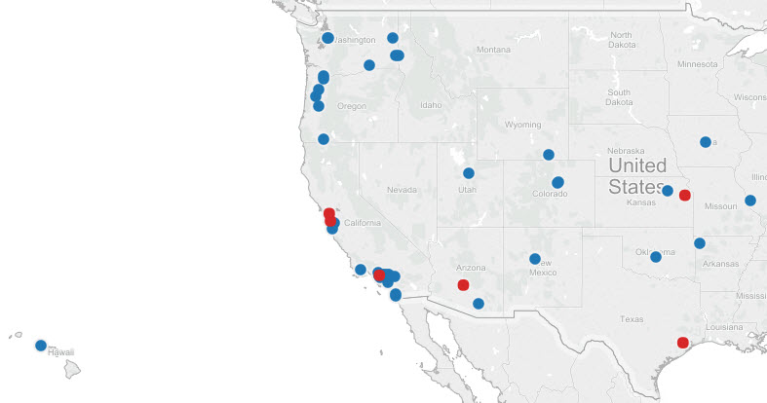
Total WEST Archive Holders/Builders: 46
Blue = Archive Holders
Red = Archive Builders
Total Archive Holders = 40
Total Archive Builders = 6
Notes:
This map showcases WEST’s distributed nature – the blue dots are Archive Holders responsible for bronze archives; the red dots are the Archive Builders responsible for silver and gold archives.
Across archiving cycles 1 through 4, a total of 46 members have committed to act as Archive Holders or Builders for WEST; that is 63% of the current WEST membership.

Slide 11
Collections Analysis Update
Collections analysis about to commence for cycles 6 and 7
Records ingested, normalized and enhanced from full members only (61 total)
Estimated 15,000+ journal families to be included in analysis
Two-years worth of archiving will be identified during the 2016 collections analysis
Notes:
Analysis of only a subset of member record
Identify archiving proposals for cycles 6 and 7 (2016-2018)
In response to member feedback from the 2014 survey
Further streamline routinized WEST activities, resulting in time and cost savings

Slide 12
Q&A

Slide 13
V. WEST Phase 2 (2013-2016)
System Development Update
Recently Released Developments:
Collection analysis and archiving enhancements
Title nominations
Needs and Offers
Notes:
Update slide

Slide 14
AGUA Decision Support and PAPR Collections Analysis
Receive unarchived holdings
Collections Analysis
Archiving Proposals
Perform Archiving work
Disclose
Collection Comparison Reports
AGUA (WEST dashboard)
AGUA
https://agua.cdlib.org
PAPR Collections Analysis (batch)
PAPR Registry

Slide 15
1. Collections analysis and archiving enhancements
The AGUA Decision Support System
New AGUA module that facilitates the WEST group collections analysis to determine what to archive next
Improved processes/functionality
  Apply regional selection criteria
  Prioritize serials with particular characteristics for archiving (by subject, year first published, etc.)
  Run various scenarios to compare the contrasting criteria and the resulting title lists
New functionality
  Redistribute proposals by selecting the “next deepest backfile”
  Compare proposals to other print archives
Notes:
WEST released AGUA, the WEST Information Center, in July 2014. Developed with the California Digital Library (CDL) PAPR team, AGUA acts as an online dashboard for WEST member libraries to review archive proposals, electronically submit archive commitments, and download both historical and current reports.
Shortly after the initial release of AGUA, WEST began developing the AGUA Decision Support System to enhance WEST collections analysis. Working again with the CDL PAPR team, WEST sought to add a staff-only module to AGUA that automates and improves various steps in the now standard WEST group collections analysis process. The AGUA Decision Support System interacts with the PAPR Collections Analysis Service (the service used for WEST collections analysis since cycle 1), and provides a graphical user interface for the collection’s analyst and the ability to more easily run collections scenarios. Developed and tested over the second half of 2014 and into January 2015, the new module was completed in February of this year in time for the cycle 5 collections analysis.
Next Deepest Backfile – historically, WEST has proposed archives to the institutions that hold the deepest backfile. However, to ensure WEST’s ability to maintain the distributed nature of the archives, we developed the functionality to easily redistribute archive proposals from the institution with the deepest backfile, to those with the next of second deepest backfile. I should note that when this occurs, these institutions still possess deep backfiles – for cycle 5, the redistributed proposals still went to members who had 96-99% of the volumes held in the deepest backfile.
Are the titles being proposed for cycle 5 archiving already disclosed as archives by other print programs in PAPR. Currently, most proposals are not held by any other archive program (at least as disclosed in PAPR). But in future, this new functionality will allow WEST and WEST archivers to make strategic decisions about adding to the optimal number of copies in the collective collection).

Slide 16
2. Title nominations
  Adopted policy and criteria for accepting title nominations (Sequoia)
  Integrated title nominations into analytic reports and PAPR Registry
  Occidental College nominated 16 titles for WEST
Notes:
Title nominations are an additional opportunity for member libraries to participate in WEST in an Archive Holder role. Under the new policy, a member library may nominate themselves to act as archive holder for a title. There is criteria for the title nominations – that the institution possesses at least 80% of the backfile, that at least 5 copies are held within WEST. Title nominations are still for journals – so WEST won’t accept monographic series or government documents. Title Nominations are reviewed by WEST’s Operations & Collections committee before they are accepted into the archive.
Accepted Title Nominations are held in place by the Archiver for the full duration of WEST's retention period. There is a form on the WEST website for Title Nominations (we’ll provide a link in the slides when we distribute them) – and nominations are accepted at any time during the year. As with the bronze, silver and gold WEST archives, disclosures for endorsed title nominations must be registered in OCLC and PAPR according to the WEST Disclosure policy. Once disclosed, title nominations become part of a new WEST archive type – WEST Sequoia.

Slide 17
3. WEST Needs and Offers (JRNL)
WEST has joined with the U of Florida/ASERL/ScholarsTrust to use the Journal Retention and Needs Listing (JRNL) system which supports gap-filling and communication among offering/needing libraries
JRNL will improve the process for filling gaps; the system publicizes “needs” (gaps) and facilitates “offers” for needed volumes.

Slide 18
Anticipated benefits of
WEST participation in JRNL
Improve efficiency of completing WEST backfiles
Support WEST library deselection efforts
Facilitate and track communication between offering libraries and Archive Builders
Expand the community of potential “offerers” and the visibility of backfile holders
Notes:
As previously mentioned, WEST Archive Builders will continue to send out calls for holdings each cycle. However, JRNL will improve our efficiency for completing WEST backfiles once our Archivers have moved onto another cycle and set of titles. JRNL will also support member libraries and their deselection efforts – particularly the JRNL functionality to batch upload ISSNs of titles to be withdrawn to determine if they can be offers.
Within the JRNL system, when a member library identifies an offer they want to make – all they need to do is select the offer button and click save – JRNL will automatically communicate your intention to make an offer to the Archive Builder (this communication is done via email – you’ll be cc’ed on the email, and it will outline the title or titles you’d like to offer).
We also expect that this will expand the community of potential offering libraries and will increase the visibility of our backfile holders (this is because the U. of Florida, ASERL and ScholarsTrust libraries will be able to view our archives and gaps) .

Slide 19
WEST Use of JRNL
AGUA functions
Manual functions
JRNL functions
Generate required JRNL files from WEST archived titles
Download WEST member JRNL files from AGUA
Import WEST member JRNL files
Identify volumes willing to offer
Fill Gaps (individual)
Search JRNL database
Offer individual volumes
Archive Holders/Builders (Needs)
Prepare ISSN file of potential offers
Fill Gaps (batch)
Import ISSN offer file
Generate report of matching titles
Any WEST library (Offers)
Notes:
JRNL asks archivers to submit archive and gap disclosures differently from WEST (where we request MARC-formatted records, JRNL requests a series of tab-delimited files). To help ease the transition to using JRNL, WEST has developed the functionality in AGUA for Archive Holders and Builders to generate and download the tab-delimited files that JRNL requires (so WEST archivers won’t have to format and develop these reports themselves – they’ll just be able to download them from AGUA). The first half of this diagram illustrates the new AGUA functionality that creates the files WEST Archivers will need to then import their WEST archive data into JRNL.
The bottom half of the diagram illustrates certain manual efforts that are already happening at member libraries – the identification of journals that need to be withdrawn. Member libraries can use their unique JRNL accounts to either search the JRNL database one title at a time (to determine if it is a title with gaps), or they can prepare list of ISSNs of potential offers that can then be imported into JRNL for an automated comparison.

Slide 20
WEST JRNL Implementation 2015
AGUA file export function developed
22 WEST libraries signed up to use JRNL, including 6 Archive Builders
More than 6,200 WEST titles uploaded to JRNL
All WEST libraries encouraged to sign up and use JRNL: send request to west-staff-l@listserv.ucop.edu

Slide 21
Q&A

Slide 22
Thank you!
http://www.cdlib.org/west
Stay informed! Subscribe to the WESTInfo-l email list via the website.
Update your contacts!
Emily Stambaugh
WEST Program Manager
emily.stambaugh@ucop.edu
Danielle Watters Westbrook
WEST Collections Analyst
danielle.westbrook@ucop.edu
Lizanne Payne
WEST Systems and Planning Consultant
lizannepayne03@gmail.com

