Slide 1
WEST Members Meeting
ALA Midwinter Conference
Seattle, WA
2019

Slide 2
Meeting Agenda
Welcome and Introductions
Overview of WEST’s Priorities for 2019
Program Updates
Membership
Archiving
Systems Development
WEST and Rosemont
Panel Discussion: Archive Builders
Analyst Recruitment

Slide 3
An Overview – WEST’s Priorities in 2019
Program assessment and strategic planning
Budget and membership fee review
New member outreach
Maximizing our efforts through partnership in the Rosemont Shared Print Alliance

Slide 4
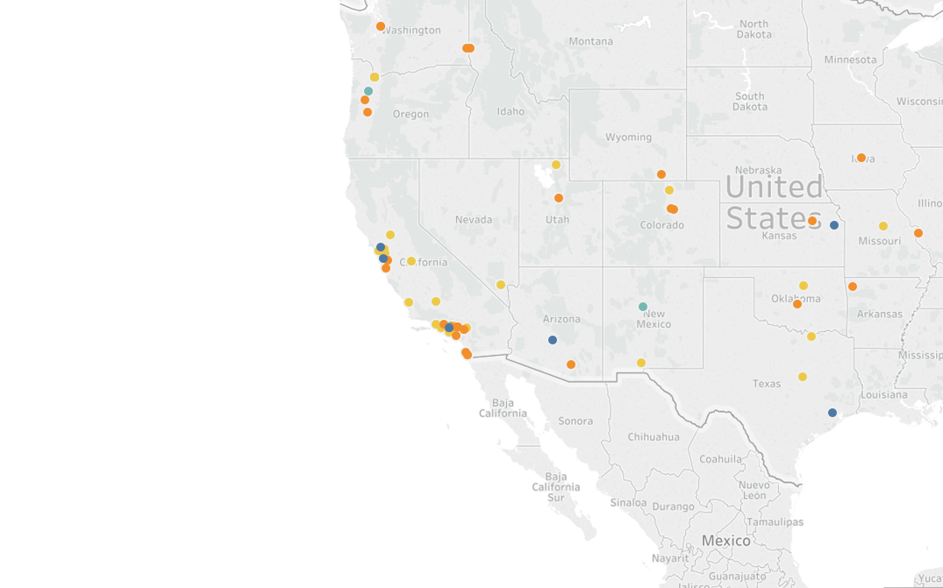
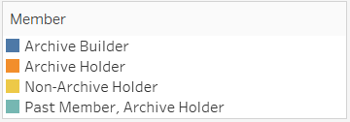
Membership Update
68 institutions west of the Mississippi
New Member – CSU Bakersfield!

Slide 5
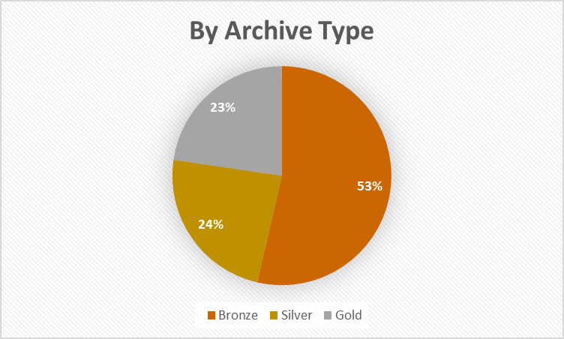
Archiving Progress
WEST Members have retained
a total of 26,246 unique titles
What’s happening now?
Archive Cycles 8 and 9
Fall 2018-Spring 2020
Fall: WEST Members committed to a total of 3,948 titles
Bronze: 1,073 titles
Silver: 1,242 titles
Gold: 1,633 titles
Cycle 8 disclosures for archived titles coming up in the spring!

Slide 6
AGUA Systems Development Phase 4
Jan/Feb, 2018
Scope wish-list
Oct-Dec, 2018
Technical specifications
March-Sept, 2018
Priority-setting with WEST governance groups; functional requirements
January, 2019
Development work begins

Slide 7
WEST and the Rosemont Shared Print Alliance
The Rosemont Shared Print Alliance is a federation of regional shared print programs with a mission to collaboratively develop, manage and coordinate the identification, retention, registration, discovery of and access to a shared, distributed collection of print journals in the United States.
Participating regional shared print programs include:
Big Ten Academic Alliance Shared Print Repository (BTAA)
Eastern Academic Scholars' Trust (EAST)
Florida Academic Libraries Repository (FLARE)
Scholars Trust (ASERL and WRLC)
Western Regional Storage Trust (WEST)

Slide 8
What’s coming up for Rosemont?
Investigating and outlining how titles are identified and selected in each program; using that knowledge in our near-term analyses to inform decision-making.
Regular communication with OCLC and CRL to monitor progress on shared print infrastructure development; communicate back to program members and provide input to OCLC/CRL based on member needs.
Outlining functional requirements and business models to leverage local tools for shared decision-making (AGUA, JRNL).
Finalizing a Last Copy Agreement to outline how the community handles last and scarce copies discovered in the course of review or deselection projects.

Slide 9
Implementing the Rosemont Access Principles
Reviewed by WEST OCC; ratified by the WEST Executive Committee.
Rosemont
64,826 titles
WEST
28,558 titles
Working across programs with library operations leadership and ILL experts
Inviting ILL experts from each of the programs to discuss best practices for implementation
Reciprocal
Retentions

Slide 10
Questions? Thoughts?

Slide 11
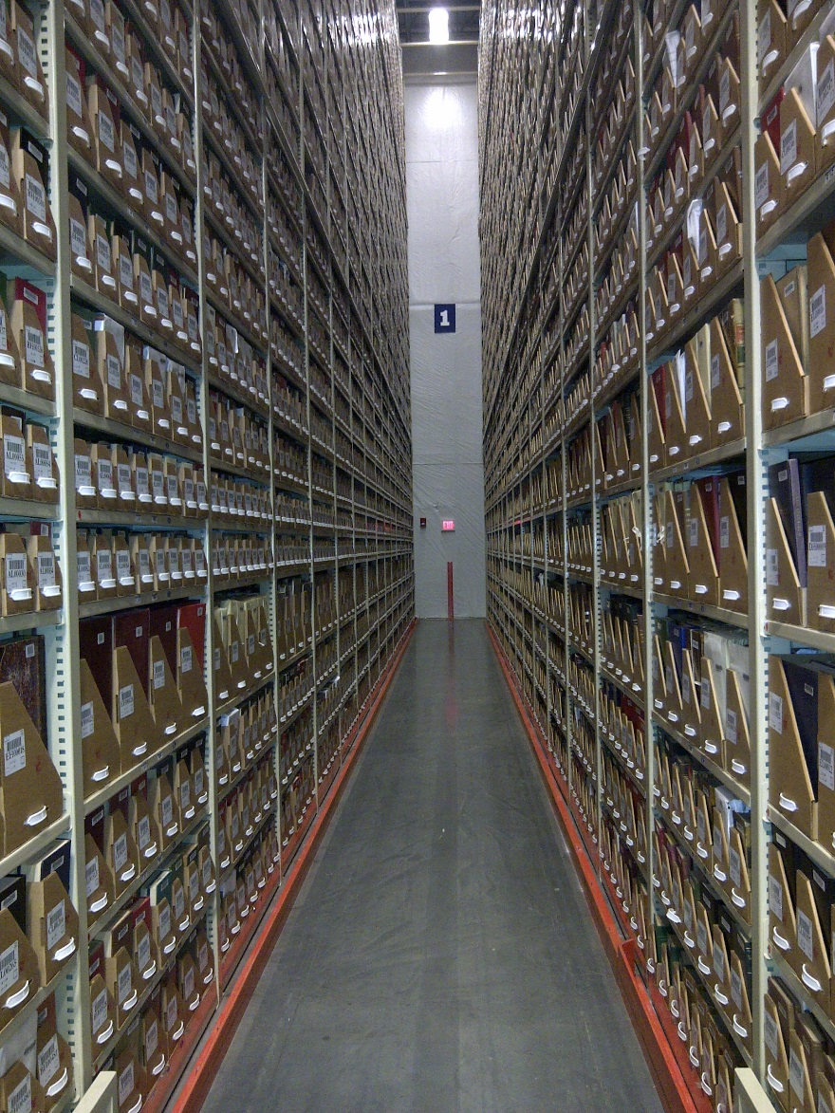
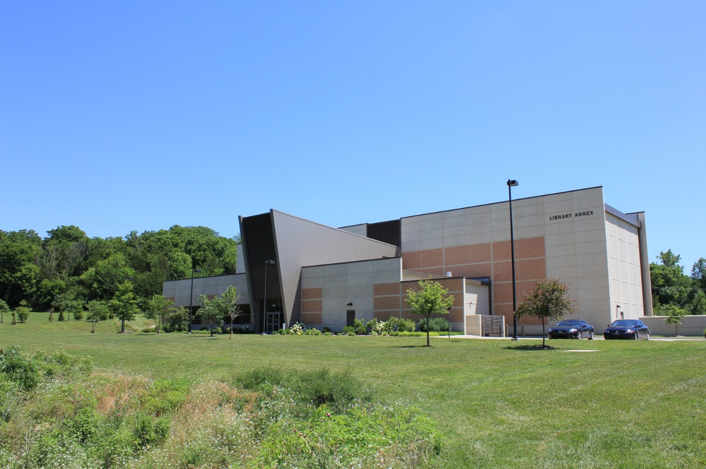
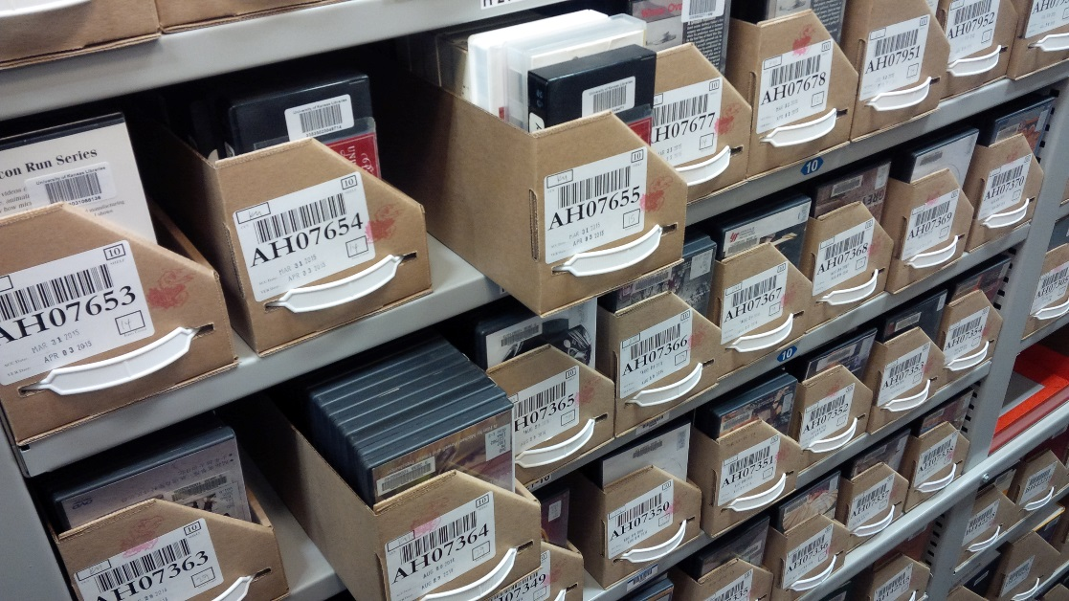
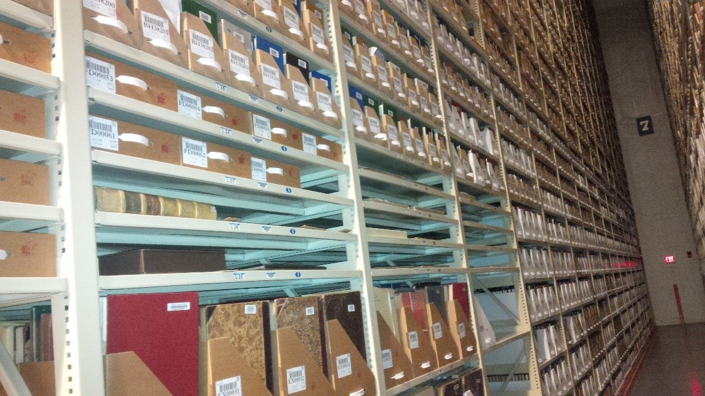
WEST Archive Builder Panel Discussion
Panelists:
Cathy Martyniak, Director, University of California, Southern Regional Library Facility
Soobum Kim, WEST Coordinator and Serials Holdings Librarian, Stanford University
Joel Smalley, Manager of Bibliographic Procurement, Arizona State University
Mira Greene, Head of Cataloging & Metadata Services, Rice University
Erika Dickey, Head of Inventory Records Management, University of Kansas

Slide 12
What characterizes Archive Builders?
Differences between Archive Holder & Archive Builder
Storage facilities that meet WEST standards
Fully enclosed and access controlled
HVAC requirements
Fire detection and suppression
Limited light exposure
Archive Builders provide dedicated staff time to coordinating and managing archive creation services as well as access and delivery

Slide 13
Off-site Annex at KU

Slide 14
Off-site Annex at KU - vault

Slide 15
WEST Archive Types (Archive Type = Level of Archiving Effort)
Characteristic | Bronze | Silver | Gold
Risk profile of title | Low risk: print & electronic full text, some with digital preservation (e.g. CLOCKSS) | Moderate risk: print with selected text access through databases | Higher risk: print with electronic abstracting or indexing or no electronic coverage at all
Physical holdings verified, summary holdings updated | No | Yes | Yes
Validation standards | None | Volume-level Completeness only | Issue-level Completeness and Condition
Fill gaps ? | No (at holder’s discretion) | Yes (active) | Yes (active)
Disclosure | Batch loaded, LHRs w 583 fields | LHRs w 583 fields, + outcomes of validation | LHRs w 583 fields, + outcomes of validation

Slide 16
Archive Holder/Builder Activities
ARCHIVE HOLDERS
ARCHIVE BUILDERS
Commit to a Title List for Bronze category
Disclose existing Holdings in OCLC & PAPR
Retain print backfile for 25 years
Re-disclose Holding changes
No direct financial support from WEST
Commit to a Title List for Bronze, Silver or Gold category
Validate Holdings for Completeness (Silver/Gold), Condition (Gold)
Perform 2 Calls for Holdings
Disclose Holdings and Problems in OCLC & PAPR
Retain print backfile for 25 years
Re-disclose Holding changes
Re-validate upon use
Financial support from WEST

Slide 17
WEST Environmental Conditions
Requirements | ARCHIVE TYPES
Risk Profile of Title | BRONZE (Low Risk) | SILVER (Moderate Risk) | GOLD (High Risk)
Storage Locations, preferred and acceptable | Library or Storage Facility | Preferred: Storage Facility Acceptable: Secured location with open stacks | Preferred: Storage Facility Acceptable: Fully-enclosed and access-controlled library area
Humidity Range | 30-70 % | 30-70 % | 30-70 %
Maximum Temperature | Less than 80° F | Less than 80° F | Less than 75° F
ATWPI – Annual Time Weighted Preservation Index |  | 50-75 | Preferred: 100 Acceptable: 70 +
Safety Systems | Fire Detection | Fire Detection Fire Suppression | Fire Detection Fire Suppression Notification to Responders
Light Exposure | Unlimited | Unlimited | Limited to work hours only

Slide 18
Sample WEST Disclosure Record: Silver
Leader cy a3n
007 ta
008 1107210u 8 1001aaeng0110728
022 0128-9035
035 1765759
561 KKU
583 committed to retain ‡c 20120629 ‡d December 31, 2035 ‡f WEST ‡f WEST Silver ‡u http://www.cdlib.org/services/west/docs/WESTProgramStatement.pdf
583 completeness reviewed ‡c 20130228 ‡f WEST ‡f WEST Silver ‡I volume-level ‡l missing volumes ‡z missing v.14,v.21
852 KKUFP ‡b LSC
866 ‡8 0 ‡a v.1 (1929)-v.13(1941), v.15(1943)-v.20(1948),v.22(1950)-v. 32(1960)

Slide 19
Sample WEST Disclosure Record: Gold
Leader cy a3n
007 ta
008 1107210u 8 1001aaeng0110728
022 0030-4050
035 1481608
561 KKU
583 committed to retain ‡c 20120629 ‡d December 31, 2035 ‡f WEST ‡f WEST Gold ‡u http://www.cdlib.org/services/west/docs/WESTProgramStatement.pdf
583 completeness reviewed ‡c 20130228 ‡f WEST ‡f WEST Gold ‡I issue-level ‡l missing volumes ‡z missing v.1-8 ‡l missing issue ‡z missing v.16:no.2(1966:June)
583 condition reviewed ‡c 20130228 ‡f WEST ‡f WEST Gold ‡I issue-level ‡l loose pages ‡z loose pages v.20:no.4(1970), v.26:no.1-no.2(1976) ‡l loose covers ‡z loose covers v.20
852 KKUFP ‡b LSC
866 ‡8 0 ‡a v.9:no.1(1959:Mar.)-v.16:no1(1966:mar.),v.16:no3(1966:Sept)-v.51:no3(2005:dec)

Slide 20
Calls for Holdings
Through validation, builders identify missing volumes and issues and materials in poor condition
Before calling, we want to make sure you own it
Holdings data provided to WEST
OCLC
Local catalog
Previous response
How much are we asking for?!?
Number of calls

Slide 21
What You Get
A contributor’s guide
A customized list in a google doc (or excel)
Ownership transfer document
WEST FAQ
Builder coordinator available for questions and assistance
Our overwhelming gratitude

Slide 22
Shared Print Operations and Collections Analyst
The position description has been finalized and posted!
Will continue as a shared position with UC Libraries Shared Print.
Posting closes: February 4th
Send questions and candidate ideas to Alison!
Also – keep an eye out for WEST Webinar Orientations/Refreshers!
For new staff with WEST roles or long-time staff who just want to revisit aspects of the program.

Slide 23
Thank you!
http://www.cdlib.org/west
Alison Wohlers
WEST Program Manager
alison.wohlers@ucop.edu

