Slide 1
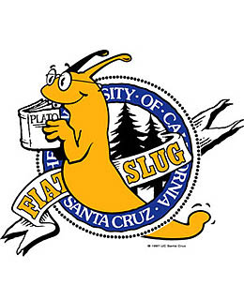
HathiTrust:
UC Collections & Services
UCLAS Webinar, May 12, 2015
Heather Christenson
California Digital Library

Slide 2
Council of University Librarians’ Priority
Capitalize on technological opportunities to accelerate the transition to a primarily digital environment
University of California Libraries, Systemwide Plan and Priorities, FY 2013-2016
http://libraries.universityofcalifornia.edu/about/vision-and-priorities

Slide 3
UC Libraries’ Mass Digitized Volumes
Google Books
3,492,720 UC volumes
≈ 13.6% of Google Books volumes (estimated)
HathiTrust
3,637,905 UC volumes
≈ 27% of HT volumes
Internet Archive
193,576 UC volumes
≈ 8% of IA-digitized volumes (estimated)
Includes locally digitized UC volumes
≈ 25 million volumes
13,334,601 total HT volumes
≈ 2.4 million IA-digitized volumes

Slide 4
Today’s presentation
What is HathiTrust?
Overview, mission, members, UC participation
What is in HathiTrust?
Overall, by library, languages, dates, copyright distribution, UC collections
A bit about copyright
How access is determined, CRMS project, the public domain, opening up rights
Services we have as a HathiTrust partner organization
Preservation, single sign on, filtering to UC or campus, print disabled services, collection building and sharing, search widget, download open access books via web and mobile, advanced full text search
Access points
Melvyl, campus catalogs, HathiTrust Research Center, Bookworm, DPLA
Service questions & communications
Future HathiTrust initiatives

Slide 5
HathiTrust
What is HathiTrust?
A shared digital repository founded in October 2008. Very large scale
A partnership community of over 100 research libraries. UC is a founding partner
Dual focus on preservation and access
Research center for computational research using text
Why is it important to libraries?
Continues and extends the historical role of libraries
Services not driven by commercial purposes
Draws upon contributions and expertise from across the partnership
Standardization enables programmatic activities
Scale enables savings
Collaboration empowers the libraries as a whole

Slide 6
HathiTrust Mission
To contribute to research, scholarship, and the common good by collaboratively collecting, organizing, preserving, communicating, and sharing the record of human knowledge.
building comprehensive collections and infrastructure
co-­owned and managed by partners.
infrastructure for digital content of value to scholars and researchers
enabling access by users with print disabilities.
supporting research with the collections.
stimulating shared collection storage strategies among libraries

Slide 7
North Carolina State University
Northeastern University
Northwestern University
Oklahoma State University
The Ohio State University
The Pennsylvania State University
Princeton University
Purdue University
Rutgers University
Stanford University
State University System of Florida
Syracuse University
Temple University
Texas A&M University
Texas Tech University
Tufts University
Universidad Complutense de Madrid
University of Alabama
University of Alberta
University of Arizona
University of British Columbia
University of Calgary
University of California
Berkeley
Davis
Irvine
Los Angeles
Merced
Riverside
San Diego
San Francisco
Santa Barbara
Santa Cruz
California Digital Library
The University of Chicago
University of Connecticut
Allegheny College
American University of Beirut
Arizona State University
Baylor University
Boston College
Boston University
Brandeis University
Brown University
Carnegie Mellon University
Case Western Reserve
Colby College
Columbia University
Cornell University
Dartmouth College
Duke University
Emory University
Florida State University
Getty Research Institute
Georgetown University
Georgia Tech
Harvard University Library
Indiana University
Iowa State University
Johns Hopkins University
Kansas State University
Lafayette College
Library of Congress
Massachusetts Institute of Technology
McGill University`
Michigan State University
Montana State University
Mount Holyoke College
New York Public Library
New York University
North Carolina Central University
University of Delaware
University of Houston
University of Illinois
University of Illinois at Chicago
The University of Iowa
University of Kansas
University of Maine
University of Maryland
University of Massachusetts, Amherst
University of Miami
University of Michigan
University of Minnesota
University of Missouri
University of Nebraska-Lincoln
University of New Mexico
The University of North
Carolina at Chapel Hill
University of Notre Dame
University of Oklahoma
University of Pennsylvania
University of Pittsburgh
University of Queensland
University of Tennessee, Knoxville
University of Texas
University of Utah
University of Vermont
University of Virginia
University of Washington
University of Wisconsin-Madison
Utah State University
Vanderbilt University
Virginia Tech
Wake Forest University
Washington University
Yale University Library

Slide 8
UC Libraries’ leadership & engagement
Board of Governors
Laine Farley (CDL), Brian Schottlaender (UCSD)
Program Steering Committee
Martha Hruska (UCSD), Todd Grappone (UCLA), Ivy Anderson (CDL)
Collections Committee
Sharon Farb (UCLA), Ivy Anderson (CDL)
Rights & Access Working Group
Sharon Farb (UCLA)
Government Documents Initiative Planning and Advisory Group
Elizabeth Cowell (UCSC), Ivy Anderson (CDL)
Print Monographs Archive Planning Task Force
Erik Mitchell (UCB), Emily Stambaugh (CDL)
User Support Working Group
Becky Culbertson (UCSD)
CRMS Project
teams at UCI, UCLA, UCSF, and CDL

Slide 9
CDL Technical development & operations
Development of standards and process to transfer digitized volumes into HathiTrust from both Google & the Internet Archive
Choosing appropriate file format for balance of function and cost (TIFF G4 + JPEG 2000 mix)
Ensuring data is present to support full functionality (discovery, access, preservation)
Enabling download and coordinating with Google, Michigan, and other partners
Specifying reporting requirements
Development for access
HathiTrust “Pageturner” interface
Link resolver “target”
Search widget
Zephir HathiTrust Metadata Management System
Launched Nov 2013
19.2 million item records in Zephir
Clustered into 7.2 million bibliographic records
There are 40 different contributor sources represented by 63 source collections
2.74 million new or updated records loaded in 2014 (first full year of production)

Slide 10
HathiTrust Digital Library includes
Currently
13,410,840 total volumes
6,793,404 book titles
355,066 serial titles
4,693,794,000 pages
601 terabytes
159 miles
10,896 tons
5,092,457 volumes(~38% of total) in the public domain
Volumes contributed from 23 partners, including UC
Brings together outputs of major mass digitization initiatives

Slide 11
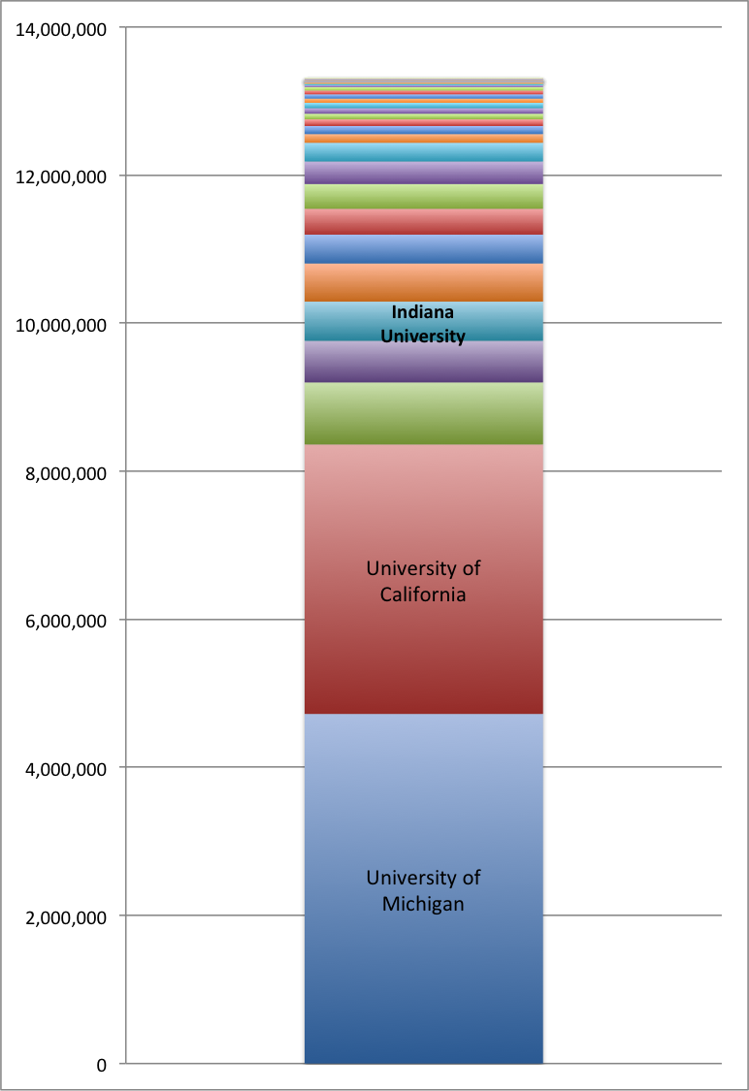
Contributions by Library April 2015 byy Library, Apr 2015
Institution | Volumes
University of Michigan | 4,722,050
University of California | 3,639,937
Harvard University | 838,122
University of Wisconsin | 561,534
Indiana University | 529,798
Cornell University | 515,753
Penn State | 389,247
University of Illinois | 348,946
University of Minnesota | 334,249
New York Public Library | 304,610
Princeton University | 252,841
Universidad Complutense | 117,322
Library of Congress | 108,892
Keio University | 90,122
University of Alberta | 76,106
Ohio State | 74,525
Columbia University | 73,396
Northwestern University | 57,000
University of Chicago | 56,981
University of Virginia | 51,207

Slide 14
Notes:
And here you can see the breakdown of what is in and out of copyright. What is in copyright is ‘dark’ but searchable.

Slide 15
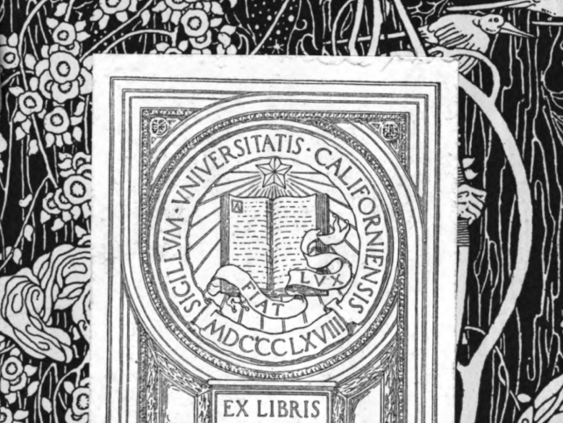
UC Library Collections in HathiTrust
Mass digitized via Google & the Internet Archive
NRLF & SRLF: all subjects, all languages
UC Berkeley: cookbooks, mathematics, selected Bancroft collections, Main library, Music Library, East Asian Library
UC Davis: California documents, Main library collection, wine collections, special collections
UCLA: children’s books, Italian comedies, rare business and economics texts, East Asian Library, Management, Chem / Biomed, Arts Library
UC San Diego: East Asia collection, IRPS, Scripps, Music, Science/Engineering
UC San Francisco: Medical library collections, special collections
UC Santa Cruz: Humanities / Social Sciences
Locally digitized
collections from UCSF, UCSD
in progress, UCLA, UCM, UCB

Slide 16
Local Digitization – Path to HathiTrust
CDL assists UC library staff to upload locally digitized volumes and metadata to HathiTrust
Path via Google
CDL consults with library to correctly package images and metadata
Direct path to HathiTrust
CDL helps:
Interpret HT requirements and documentation
Test sample images and interpret results
Interface with Michigan staff on image remediation and metadata issues
Assists in the completing HT paperwork: DASI, Submission Inventory, missing metadata, etc.
If your library would like to upload locally digitized materials to HT, please consult CDL as early in the process as possible.

Slide 17
HathiTrust Rights Status – Public Domain
HT automatic rights algorithm assigns “Public Domain” status to books published in the US prior to 1923 and to works published outside the US prior to 1875. These are open access to everyone.
HT automatic rights algorithm assigns “Public Domain – United States” status to books published outside the US during years 1875 – 1922. These are only open to users in the United States.
CRMS World reviewers are currently conducting author death date research for works published in the UK, Canada, and Australia between 1875 and 1945 (for the UK) and 1965 (for Canada and Australia). When legally appropriate, volumes are re-assigned the rights status “Public Domain”
The year 1875/1945/1965 moves up an increment each January 1st

Slide 18
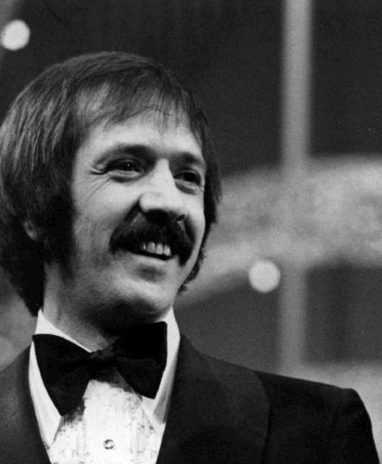
Public Domain Extension?
Works published in 1923 should enter the public domain in the U.S. on January 1, 2019.
Thereafter, the year should increment by one every January 1st.
This is thanks to the Sonny Bono Copyright Term Extension Act of 1998.
Prior to 1998, copyright in published works lasted at most 75 years, the Sonny Bono act extended all existing copyrights by 20 years.
This is why works published before 1923 are in the public domain: 1922 + 75 = 1997 (the year before the new rule took effect)
However, Congress could grant another copyright extension before 2019 and prevent more works from entering the public domain.

Slide 19
HT CRMS (Copyright Review Management System)
In the past 6 years CRMS project staff have reviewed 511,520 volumes for copyright status and have been able to open 270,979 volumes (or 52.96%) to the public.
CRMS U.S. (2008 - 2014) reviewed volumes published in the United States between 1923 and 1963.
CRMS World (2014 – 2016) Reviewers are currently conducting author death date research for works published in the UK, Canada, and Australia between 1875 and 1945 to determine if they are in the public domain.
UC staff from UC Irvine, UC Los Angeles, UC San Francisco, and CDL are currently conducting reviews
CRMS projects have been funded via National Leadership Grants from IMLS (Institute of Museum and Library Sciences)

Slide 20
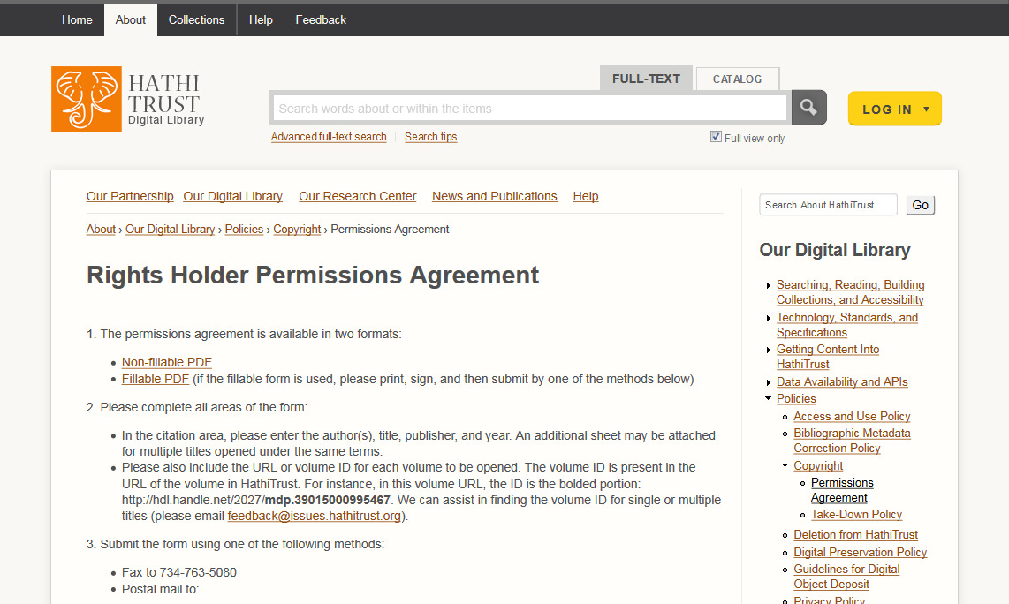
UC Rights Holders may open their publications in HathiTrust for public access
http://www.hathitrust.org/permissions_agreement

Slide 21
Digital Preservation
Long-term commitments on digital content facilitate decision-making about digitization efforts and print collections management
“Use of standard and open content formats that meet community-accepted digital preservation standards, are widely supported on a number of platforms, and that we are confident can be preserved and migrated forward to new preservation formats over time”
“Reliance on standards for repository design and trustworthiness such as OAIS and TRAC”
http://www.hathitrust.org/preservation

Slide 22
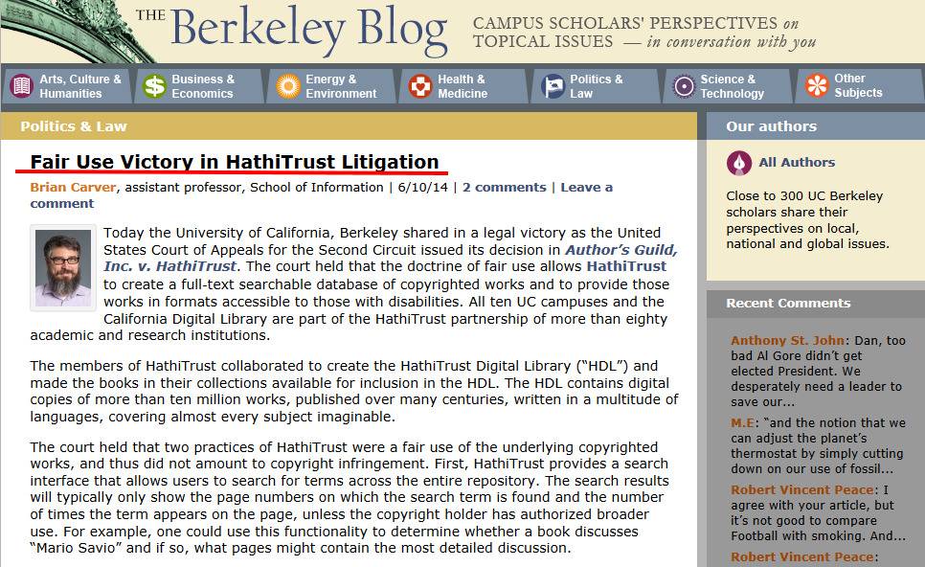
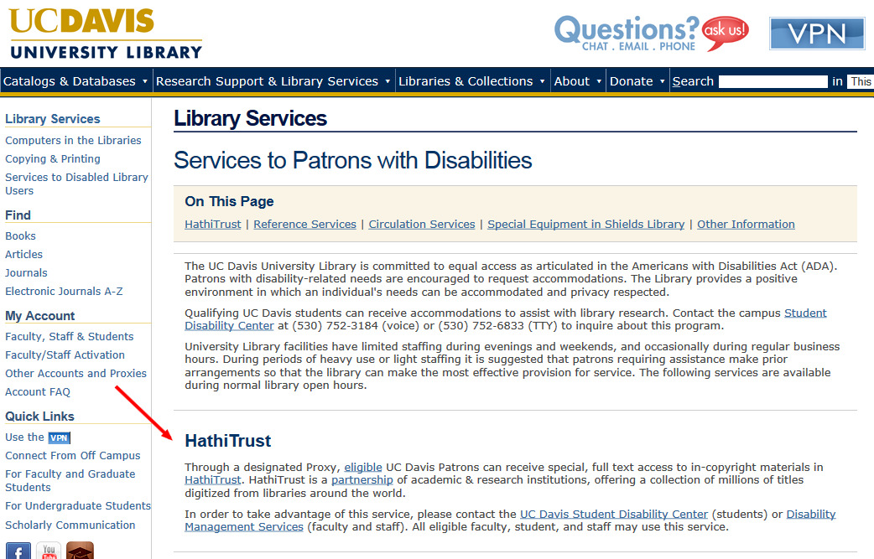
HathiTrust Services for Print Disabled
Quote: Brian Carver, assistant professor, School of Information, UC Berkeley

Slide 23
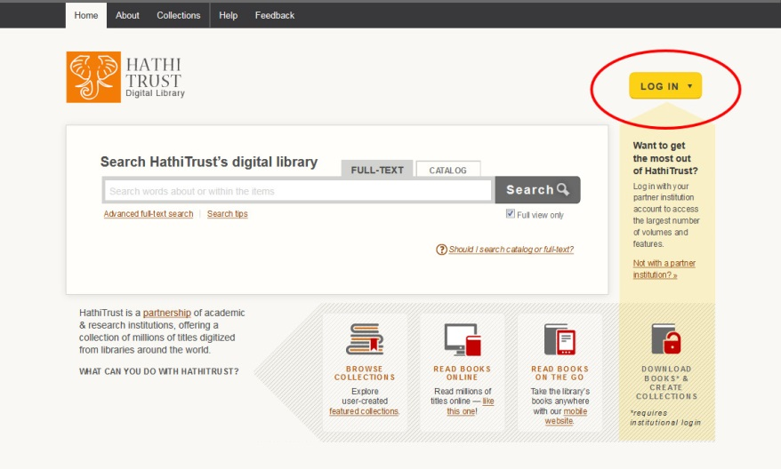
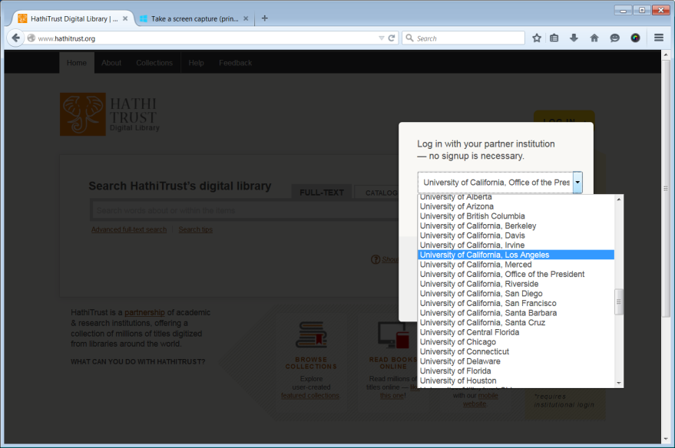
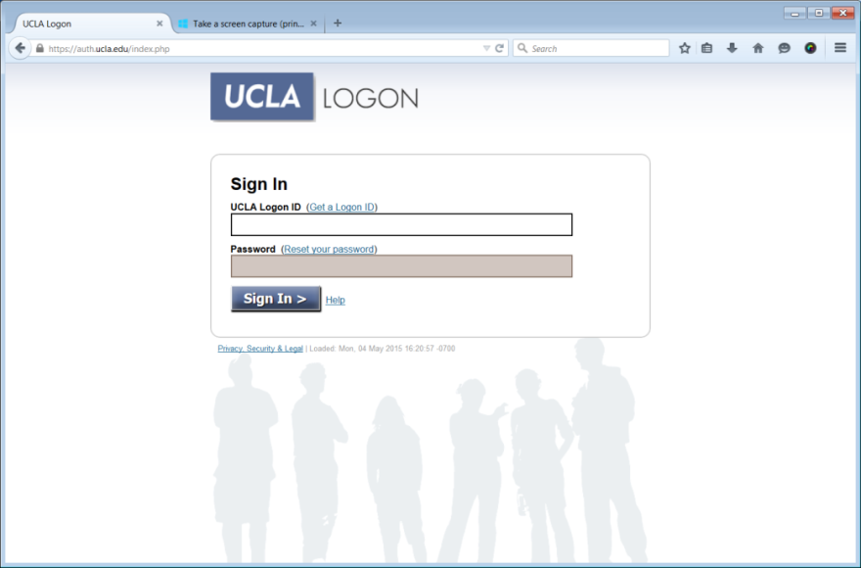
Simple log in using existing university credentials via Shibboleth
Go to HathiTrust.org
Click the yellow “Log in” button in the top right-hand corner
Select your institution from the dropdown box
Sign in via your university credentials

Slide 24
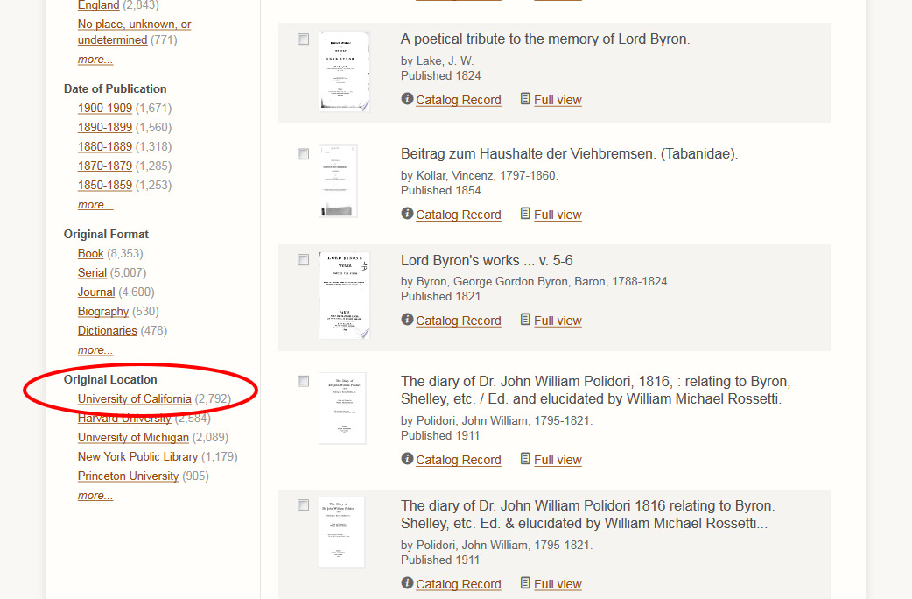
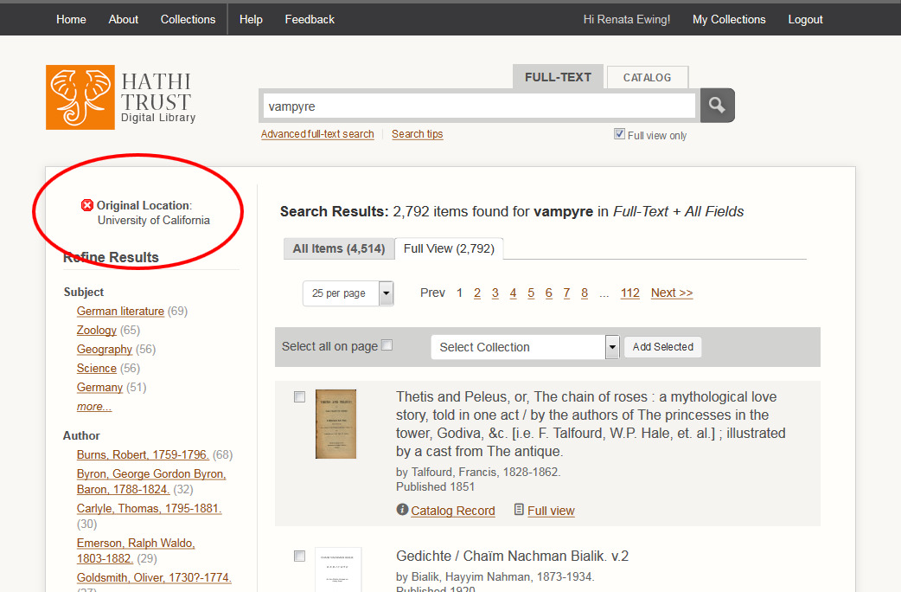
Limit HT Search Results to UC Volumes Only
From search results page, scroll down to “Original Location” in the “Refine Results” column on the left side of the page.
Click “University of California”
Search results will now only include volumes from UC

Slide 25
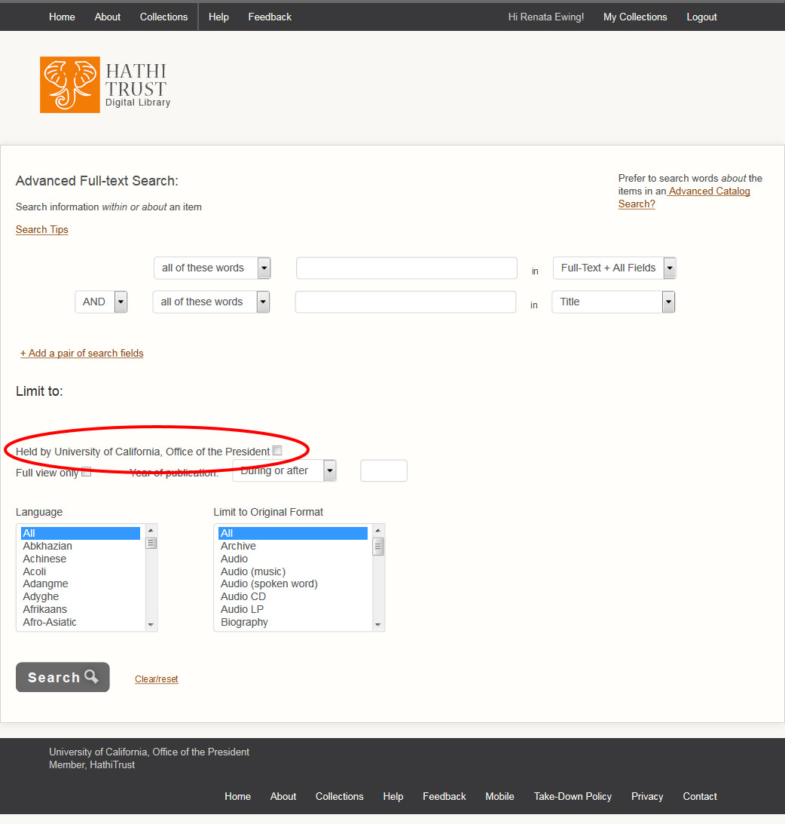
Limit Search Results to Volumes Held by Your Campus
Login to HathiTrust
Go to Advance Full Text Search
Fill in your search query and then check off the box under the “Limit to” section
Click “Search”

Slide 26
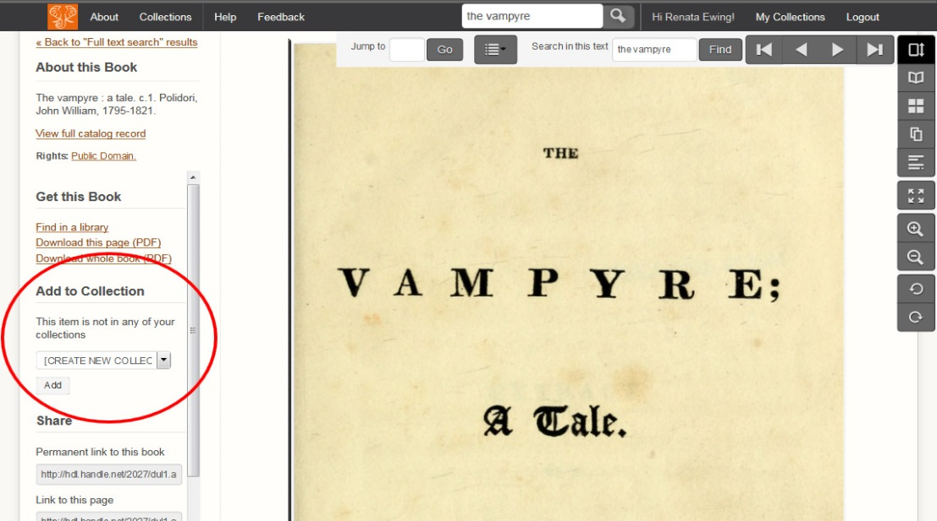
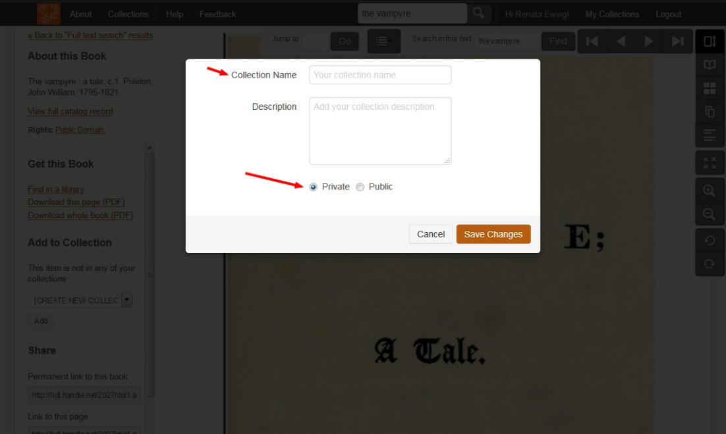
Collection Building: from a Book Page
1. From a book page, select “Create New Collection” from the drop box on the left-hand side of the page under “Add to Collection”
2. Add a name for your collection and click to make it either private or public
3. Click “Save Changes”

Slide 27
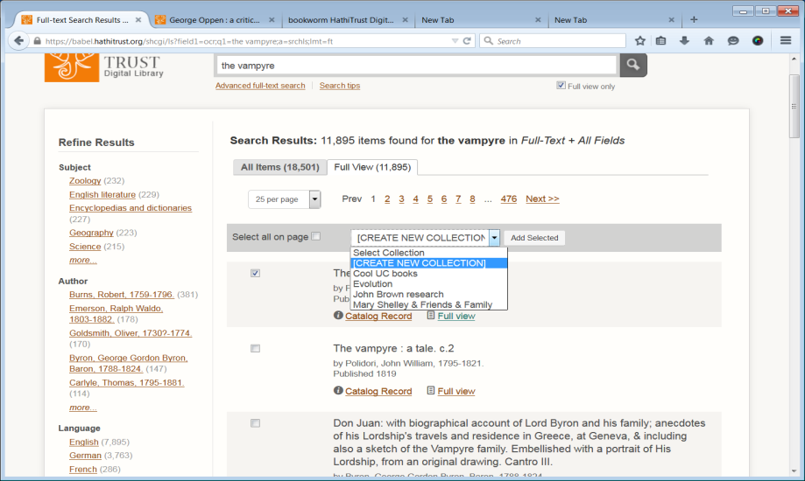
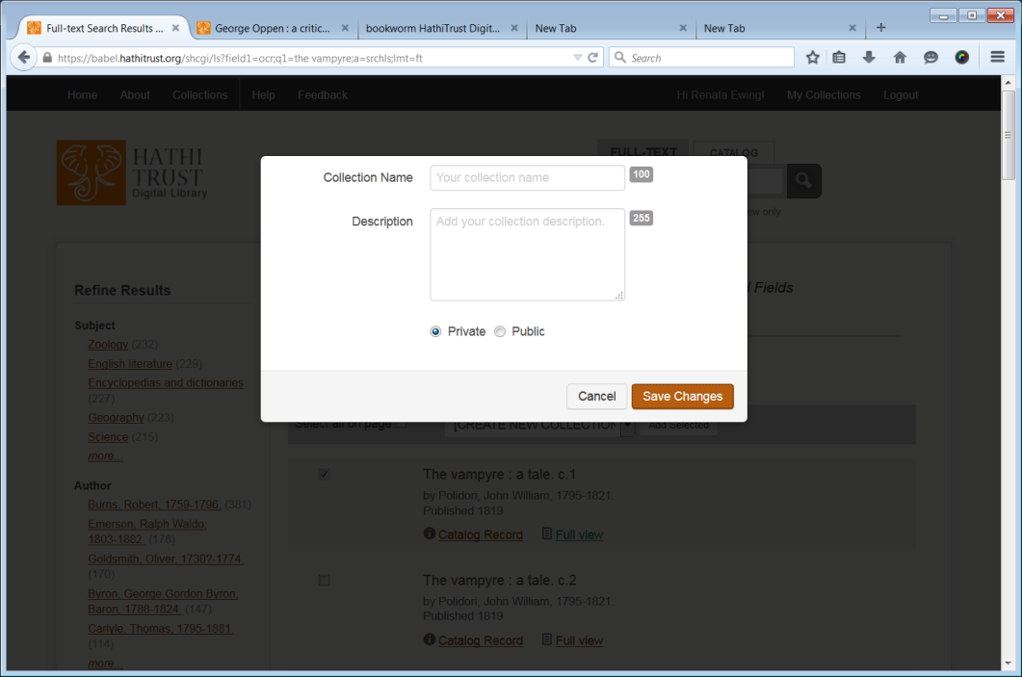
Collection Building: from Search Results
Enter a query for full text-search search
Select at least 1 item to add to your collection by checking on a box beside each search result
3. Select “Create New Collection” from drop down list on gray bar above search results and click “Add Selected”
Add a name and click to make your Collection private or public

Slide 28
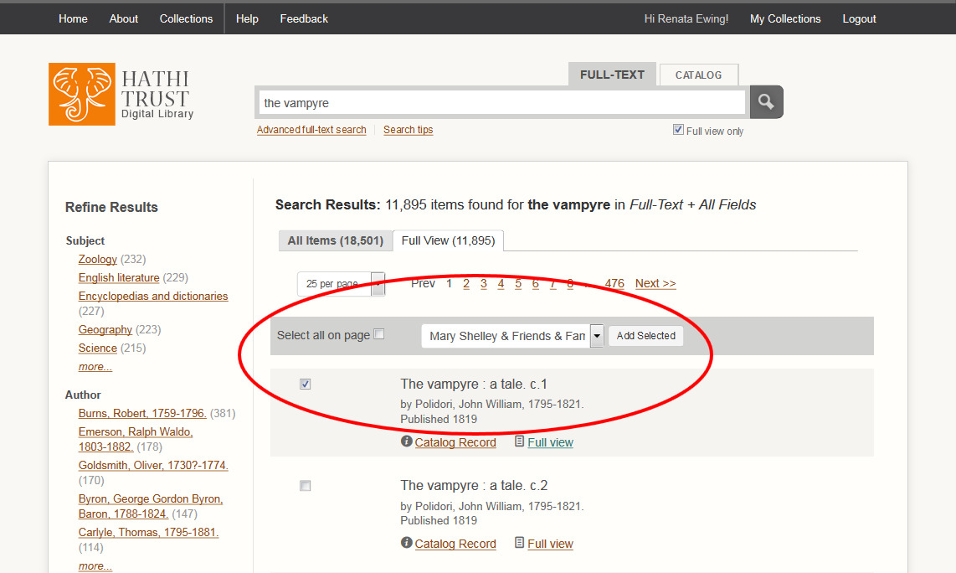
Add Items to Your Collection
You can add a volume (or volumes) to your collection in the same way you created a collection – via a book page or search results.
Select your collection name from the same drop down list and the selected volume/s will be added to the selected collection.

Slide 29
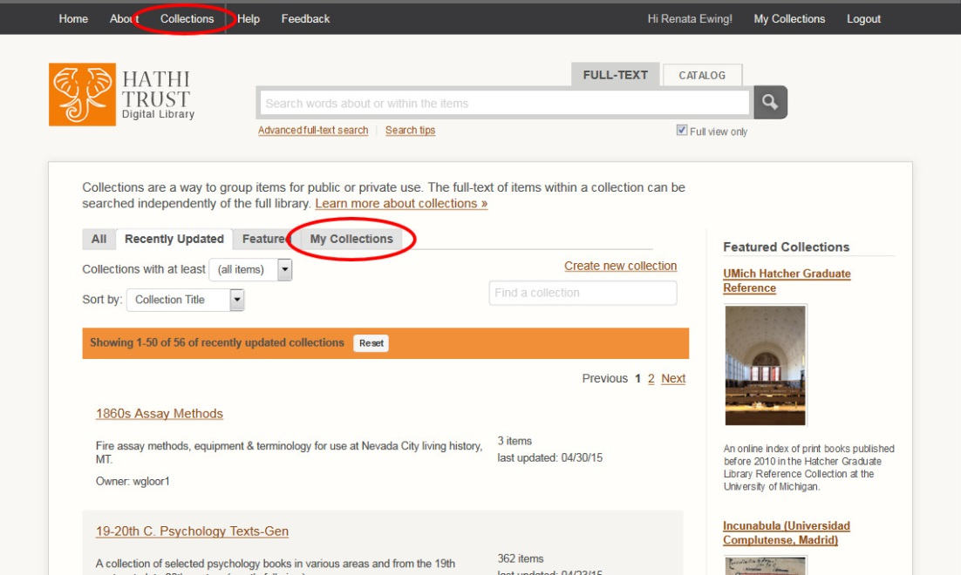
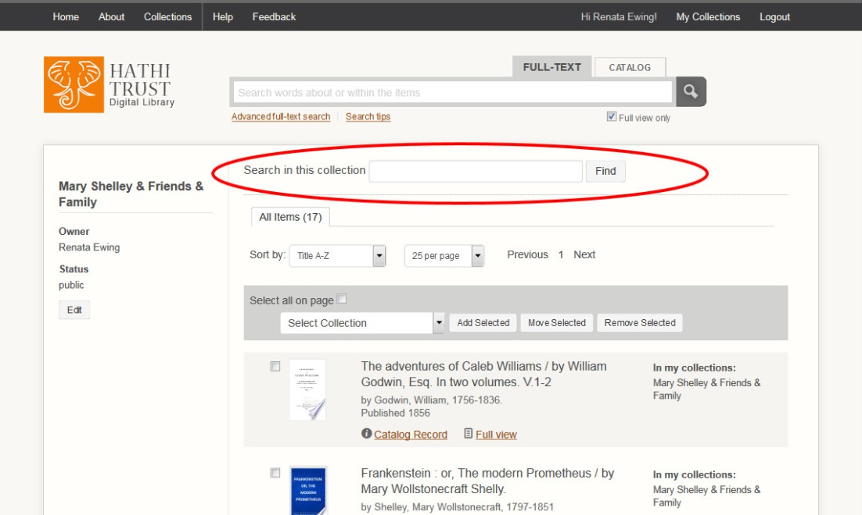
Accessing and Sharing your collections
To share your collection, go to HathiTrust.org and click “Collections” from the top navigation bar. Then click the “My Collections” tab
Next, click the collection you want to share from your list of collections
Your collection page will open. It has an unique URL which you can share with others.
You have the ability to search only within your collection.

Slide 30
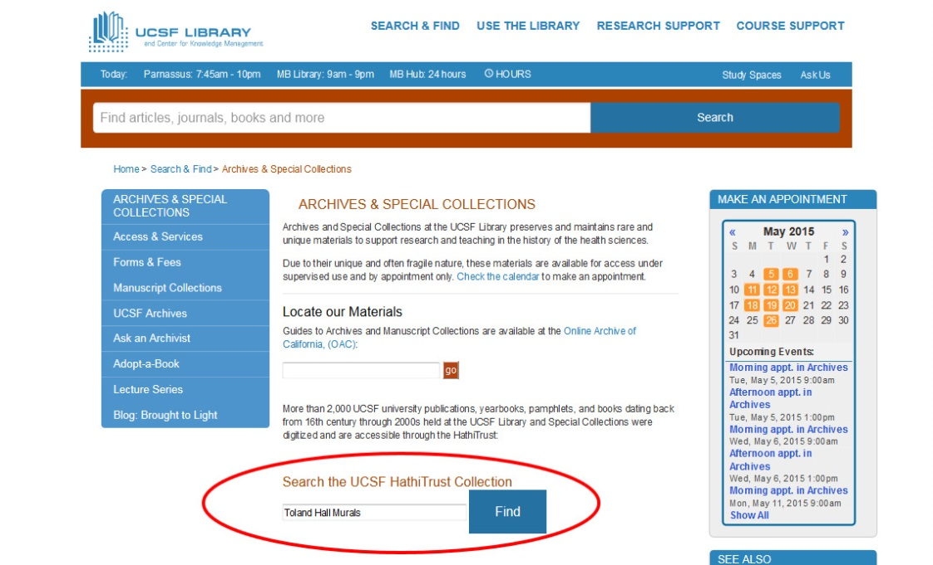
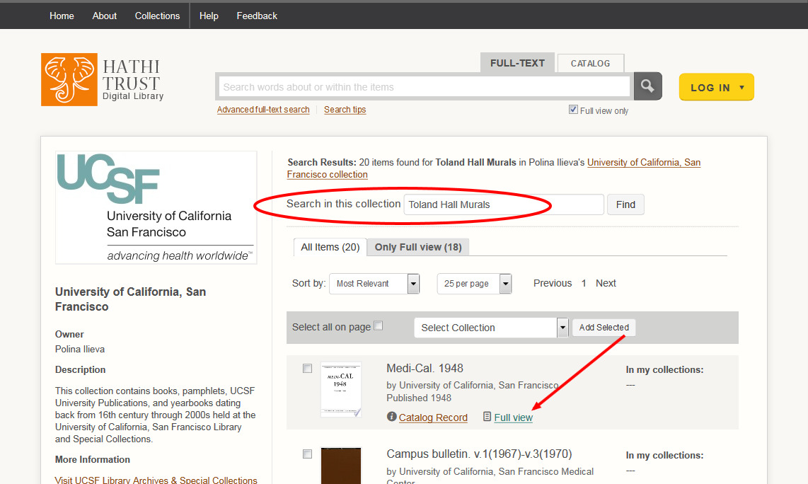
UCSF Collection Search Widget
CDL staff created a search box for UCSF’s collection on HT
1. Enter a search term from UCSF’s Archive page and go directly to results within UCSF’s collection on HathiTrust

Slide 31
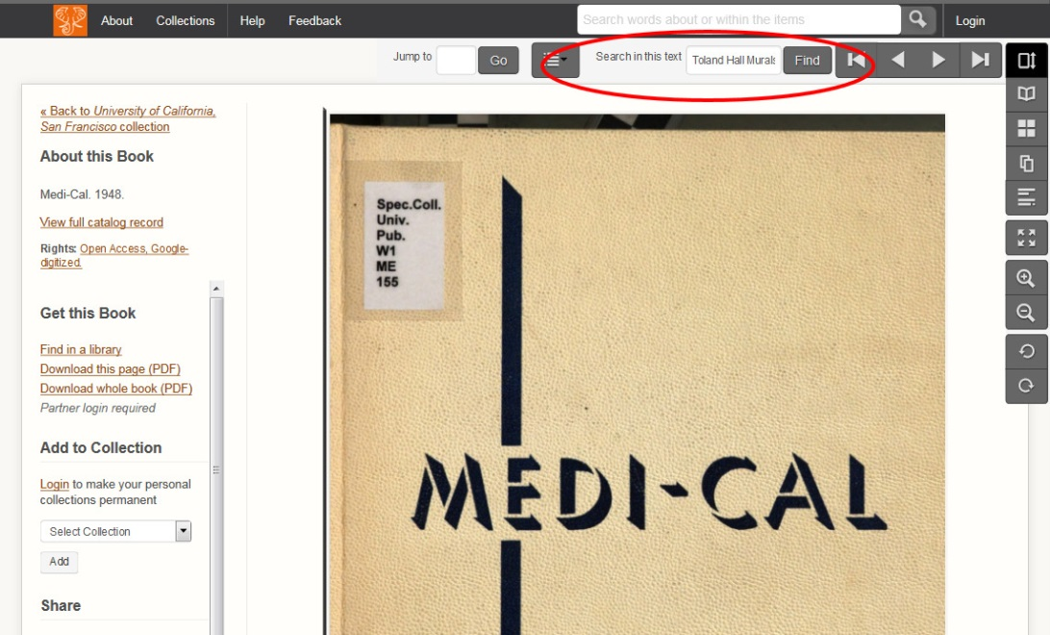
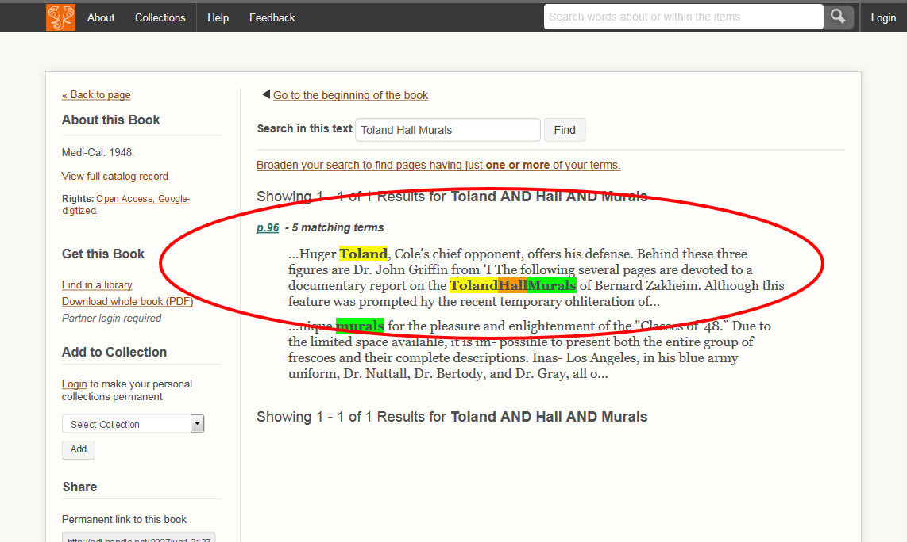
UCSF Collection Search Widget
2. Select a volume and go directly to the search inside the book option with your search term already entered.
3. View your search within the book results

Slide 32
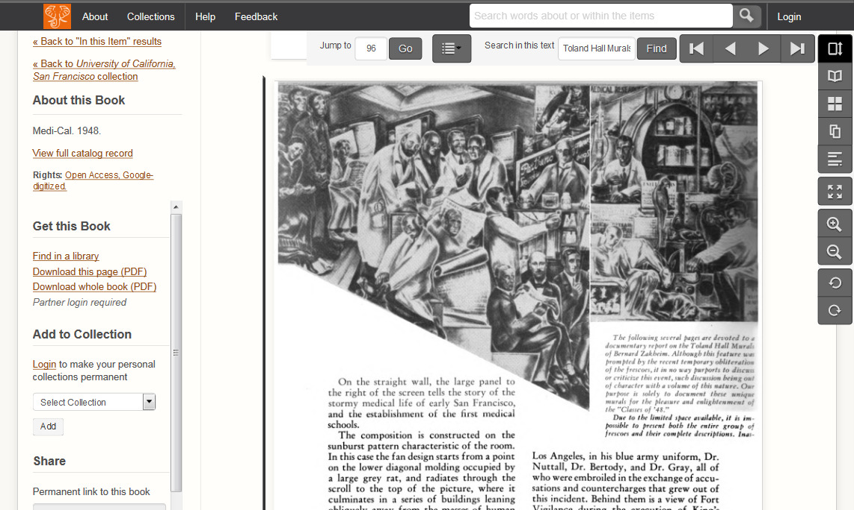
UCSF Collection Search Widget
4. Select the page you want to see and go directly to the page which contains your search term

Slide 33
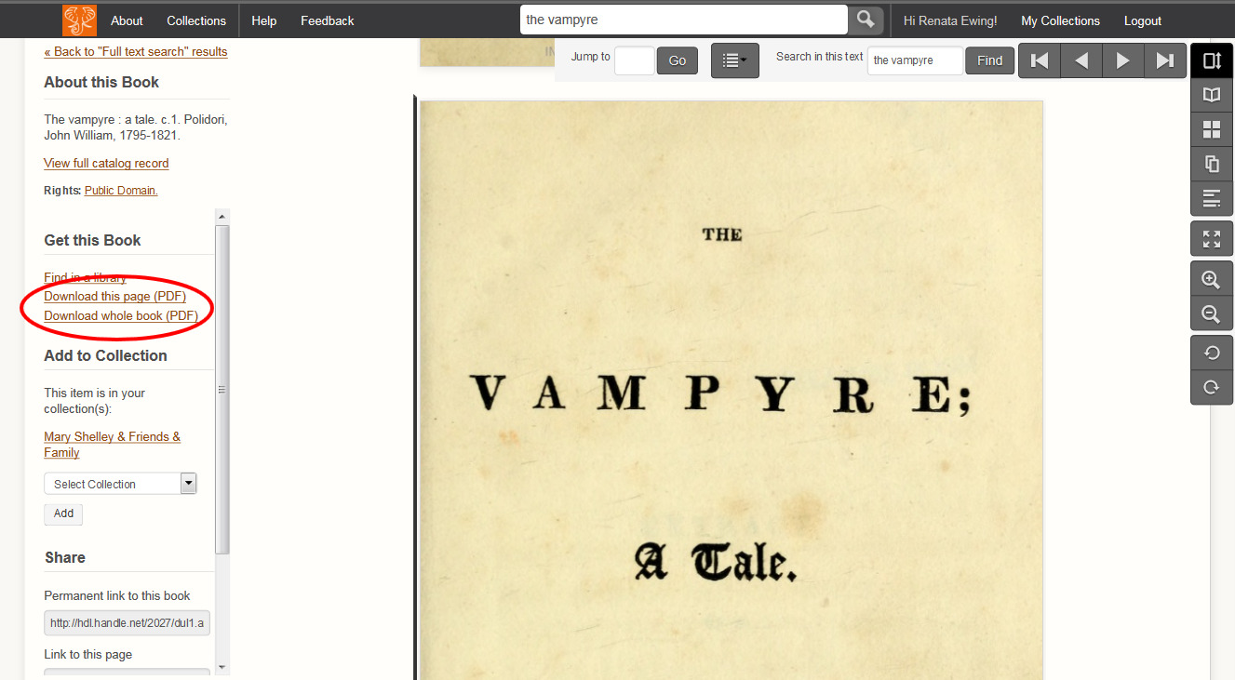
Download Open Access Books
Make sure you are logged into HathiTrust
Go to a full view book page for the book you want to download
Click “Download Whole Book (PDF)

Slide 34
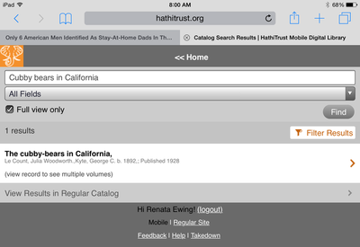
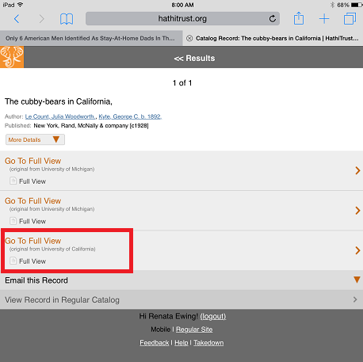
Downloading Open Access Text via Mobile Device
Go to HathiTrust.org on your mobile device
Log in
Enter a search term and click “find”
4. Select the volume you want from the results
5. Select to go to “Full View” volume from the institution you prefer

Slide 35
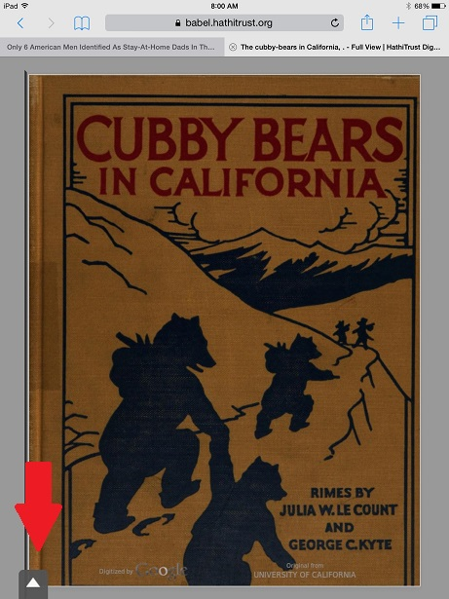
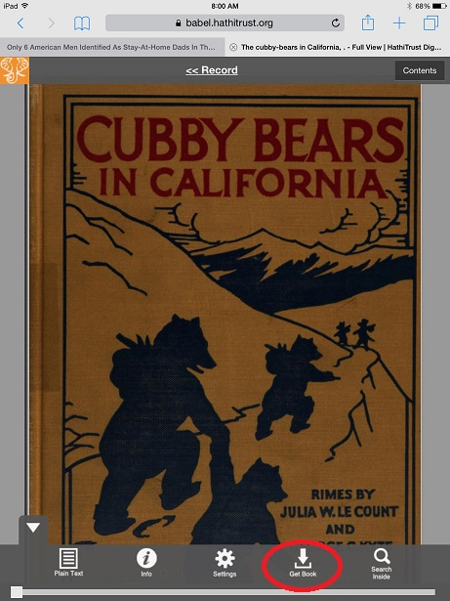
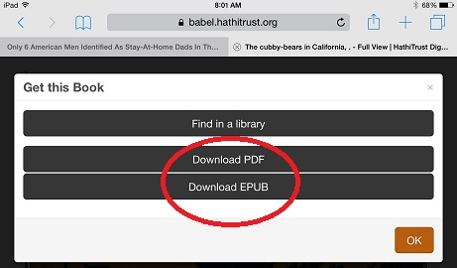
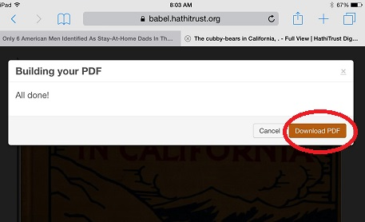
5. Click the white arrow at the bottom of the screen to open the menu
6. Click “Get Book” icon
7. Choose to download either a PDF or EPUB
8. Wait until your PDF is finished building and click “Download”

Slide 36
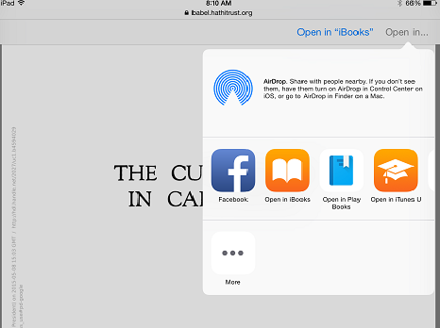
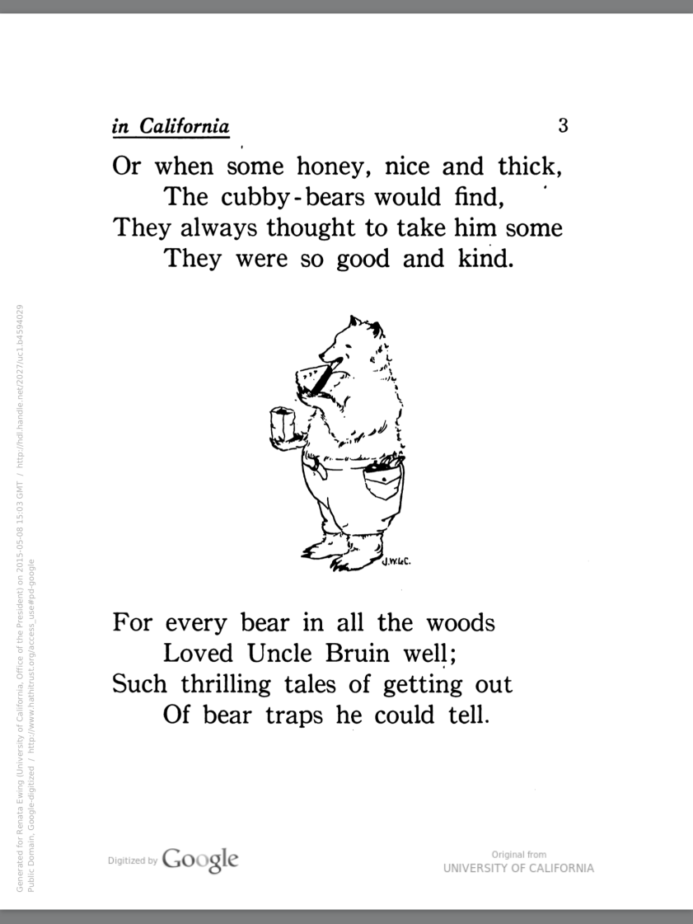
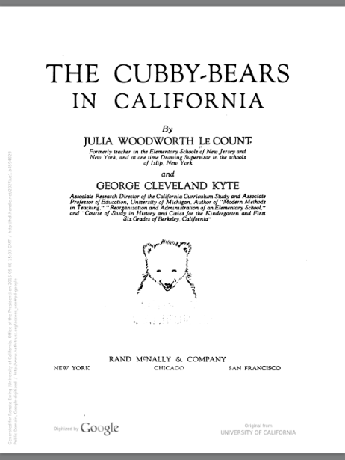
9. Select where you’d like to save and read your volume
10. Read your book using your device from anywhere!

Slide 37
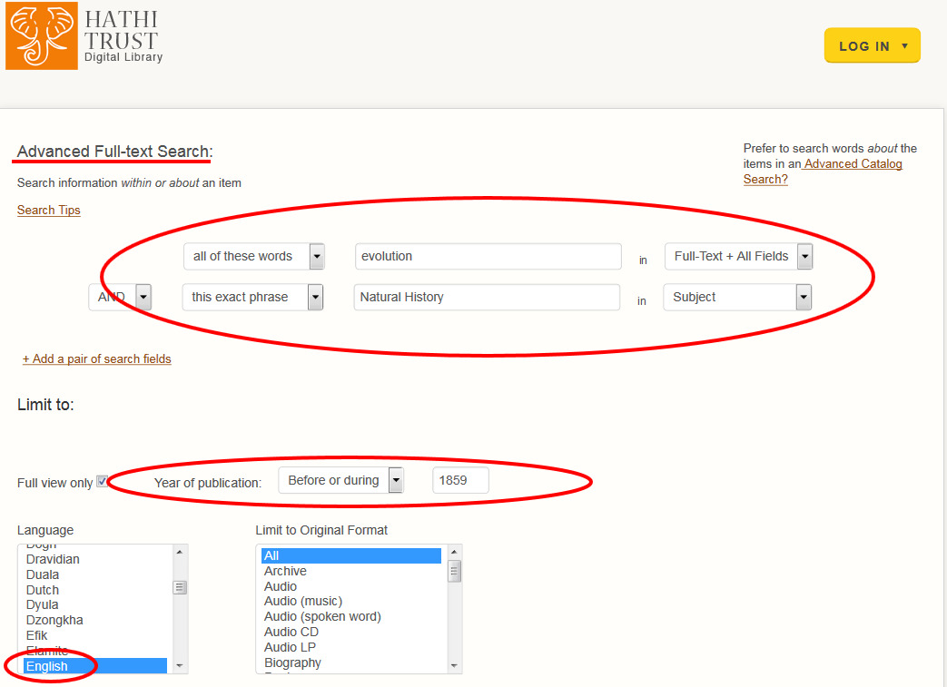
HathiTrust Advanced Full-Text Search

Slide 38
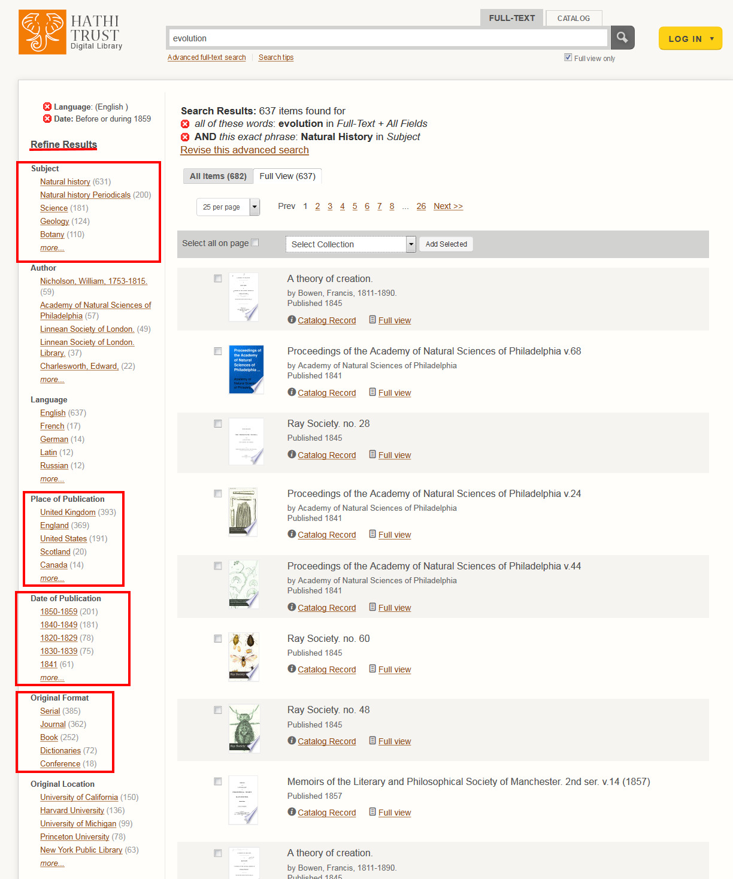
Refining Search Results

Slide 39
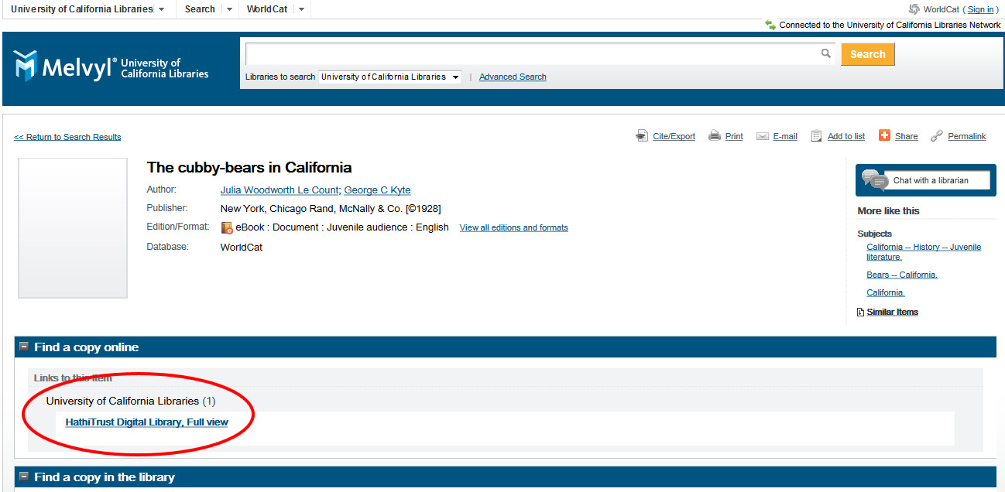
HathiTrust Links in Melvyl (via OCLC)
http://www.cdlib.org/services/d2d/melvyl/Melvyl_FAQ.html#hathi1
FAQ
http://www.cdlib.org/services/d2d/melvyl/Melvyl_FAQ.html#hathi1

Slide 40
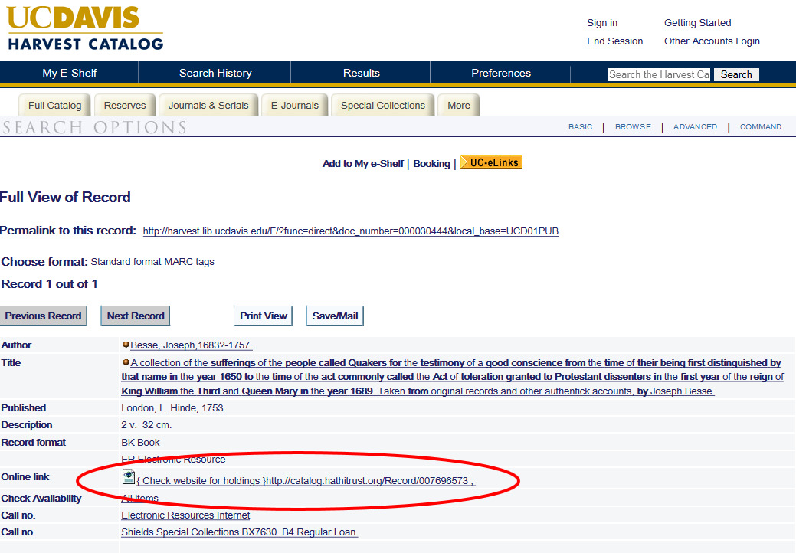
HT Links in UC Davis Catalog

Slide 41
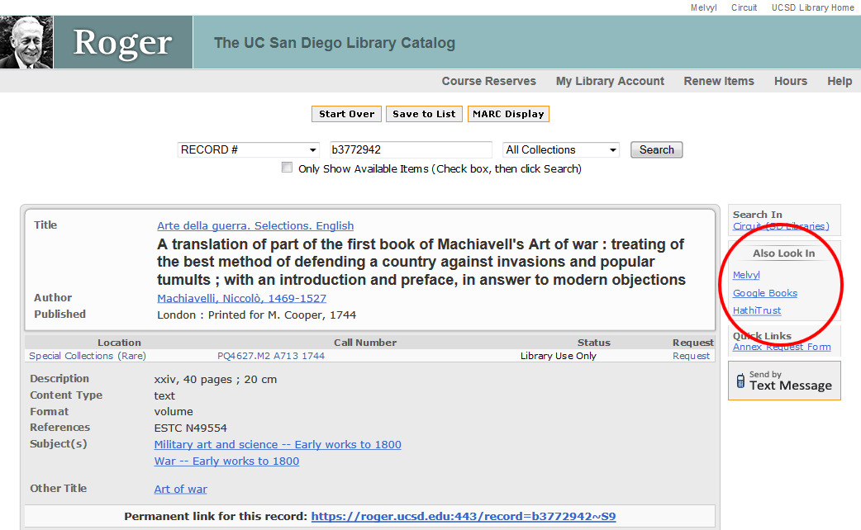
HT Links in UCSD Catalog

Slide 42
HathiTrust Research Center (HTRC)
Bring researchers to the data
Starting with public domain materials
Support “non-consumptive” research
Evolve around user demand
Distribution of datasets
http://www.hathitrust.org/datasets
Access for researchers
Assemble worksets
Browse volume lists and algorithms, execute algorithms, view results
Sandbox: can run own algorithms

Slide 43
Example Projects Supported by HTRC
Muñoz, Trevor, University of Maryland. “Distributed Metadata Correction and Annotation.”
Correction, annotation and enhancement of HT records and export as linked data
Page, Kevin, Oxford University. “ElEPHãT: Early English Print in HathiTrust, a Linked Semantic Workset Prototype”
Development of secondary worksets based on both HT and the Early English Books Online Text Creation Partnership (EEBO-TCP).
Burton, Vernon. “The South as ‘Other,’ the Southerner as ‘Stranger.’”
Explore how attitudes expressed in print about slavery, southerners, and non-southerners have changed over both time and space.
Ted Underwood, Associate Professor of English at the University of Illinois, Urbana-Champaign.
Using public domain texts received from HathiTrust to explore changing relationships in literary genres from 1700-1899.

Slide 44
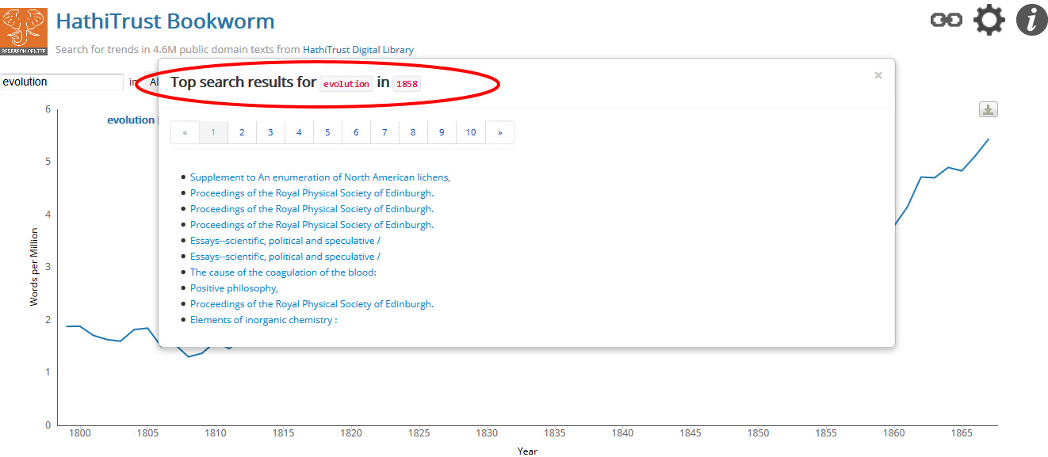
HathiTrust Bookworm, as alternative search interface
http://bookworm.htrc.illinois.edu/

Slide 45
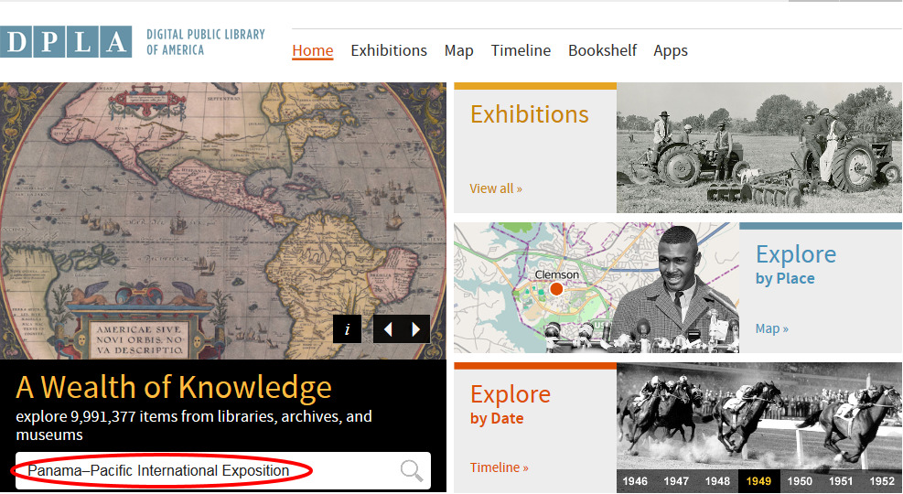
HathiTrust in DPLA
Hathitrust is one of over 40 content hubs providing metadata to be searched on the Digital Public Library of America which resolve to digital objects. DPLA is a way to search HathiTrust alongside many sources of rich digital materials which include text, sound, and moving images.
1. Enter search terms

Slide 46
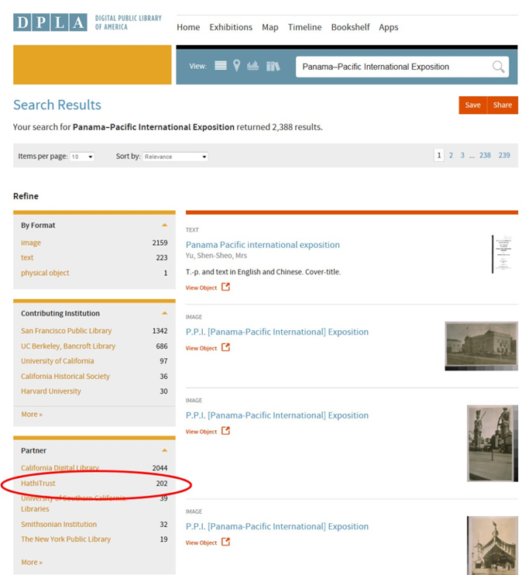
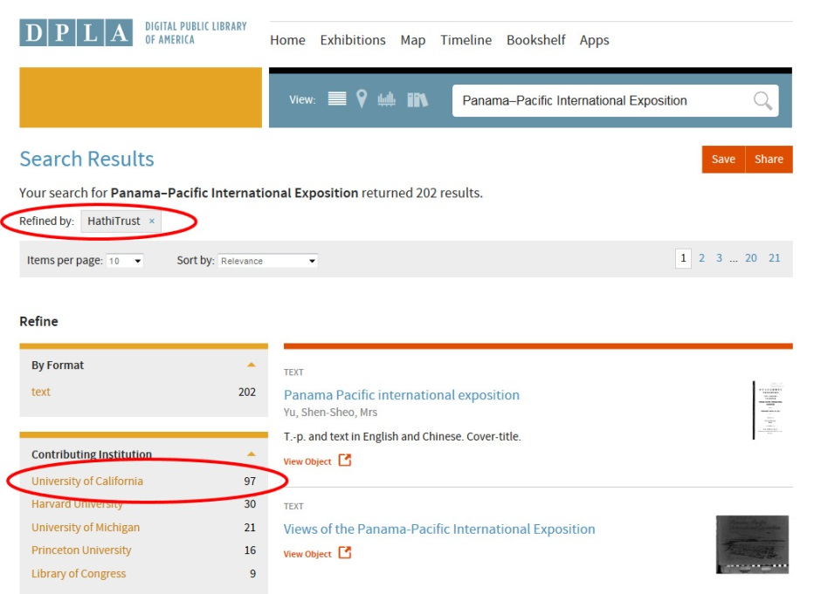
2. Refine search results to include only HT results
3. Refine results further to include only UC items in HT

Slide 47
2. Refine search results to include only HT results
3. Refine results further to include only UC items in HT

Slide 48
Service & Communications Qs
What happens when I use the HathiTrust Feedback button?
Some issues scale to multiple campuses, some don’t:
Implementation of print disabled services
Replacement copies
Opening up rights
Can I get a book in that I want in there?
How do I correct a record?

Slide 49
Future HathiTrust Initiatives
Shared Print Monographs Archive
US Federal Government Documents Initiative
Collections assessment: non-print?
Metadata policy
Quality characterization & improvement
Methods to solicit and evaluate proposals for development
Translating HathiTrust Research Center research into operational services
Continue to expand lawful uses

Slide 50
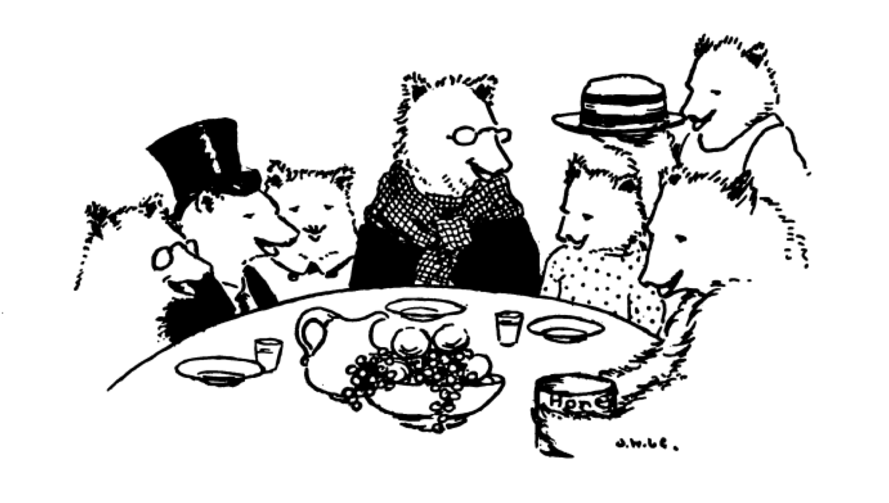
A NOTE OF THANKS
To each and every person on every campus who has contributed to UC’s mass digitization projects!
Your hard work is the foundation of this digital library.

Slide 51
More Information
HathiTrust
www.hathitrust.org
About: http://www.hathitrust.org/about
Resources: http://www.hathitrust.org/resources
Twitter: http://twitter.com/hathitrust
Facebook: http://www.facebook.com/hathitrust
Monthly newsletter: http:www.hathitrust.org/updates
Contact: feedback@issues.hathitrust.org
Blogs: http://www.hathitrust.org/blogs
HathiTrust Research Center
www.hathitrust.org/htrc/
2015 Uncamp: http://www.hathitrust.org/htrc_uncamp2015
UC Mass Digitization Projects
http://www.cdlib.org/services/collections/massdig/
Contact: Heather.christenson@ucop.edu
Thanks to Mike Furlough, HathiTrust Executive Director, for sharing slides, & Renata Ewing (CDL) for her assistance
http://babel.hathitrust.org/cgi/pt?id=uc1.b4594029;view=thumb;seq=1
Questions?

Slide 52
Main points in Authors Guild v. HathiTrust decision
Section 108 on library privileges doesn’t limit the scope of fair use.
A search index and access for the print-disabled are both fair uses.
Search indexing is a transformative use.
The libraries aren’t making commercial uses, even though they partnered with Google to get the scans.
The plaintiffs haven’t proven that HathiTrust is creating any security risks.
There is no market for scanning and print-disabled access, nor is one likely to develop.

