Slide 1
What’s Next for HathiTrust?

Slide 2
We’re Growing Up!

Slide 3
Partnership
Arizona State University
Baylor University
Boston University
California Digital Library
Columbia University
Cornell University
Dartmouth College
Duke University
Emory University
Getty Research Institute
Harvard University Library
Indiana University
Johns Hopkins University
Lafayette College
Library of Congress
Massachusetts Institute of Technology
McGill University
Michigan State University
New York Public Library
New York University
North Carolina Central
University
North Carolina State
University
Northwestern University
The Ohio State University
The Pennsylvania State
University
Princeton University
Purdue University
Stanford University
Texas A&M University
Universidad Complutense
de Madrid
University of Calgary
University of California
Berkeley
Davis
Irvine
Los Angeles
Merced
Riverside
San Diego
San Francisco
Santa Barbara
Santa Cruz
The University of Chicago
University of Connecticut
University of Florida
University of Illinois
University of Illinois at Chicago
The University of Iowa
University of Maryland
University of Miami
University of Michigan
University of Minnesota
University of Missouri
University of Nebraska-Lincoln
The University of North Carolina
at Chapel Hill
University of Notre Dame
University of Pennsylvania
University of Pittsburgh
University of Utah
University of Virginia
University of Washington
University of Wisconsin- Madison
Utah State University
Yale University Library

Slide 4
Content over time
* As of September 24, 2011
Notes:
4

Slide 5
HathiTrust Content Growth
Notes:
5

Slide 6
CONSTITUTIONAL CONVENTION “ConCon”
Governance
Collection Management
Mission and Goals
Development Process
http://www.hathitrust.org/constitutional_convention2011

Slide 7
New Governance Structure
Executive Committee
(5 Members)
Board of Governors
(13 Members)
(2 permanent UC seats)
Committees and Working Groups

Slide 8
COLLECTION MANAGEMENT
Print Monographs Archive
Government Documents

Slide 9
A global change in the library environment
Academic print book collection already substantially duplicated in mass digitized book corpus
June 2010
Median duplication: 31%
June 2009
Median duplication: 19%
Notes:
9

Slide 10
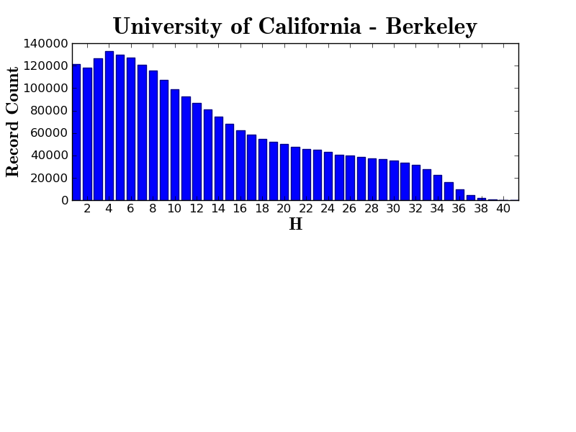

Slide 11
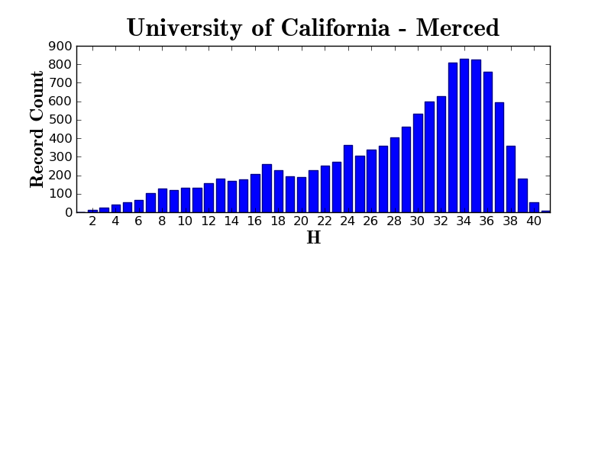

Slide 12
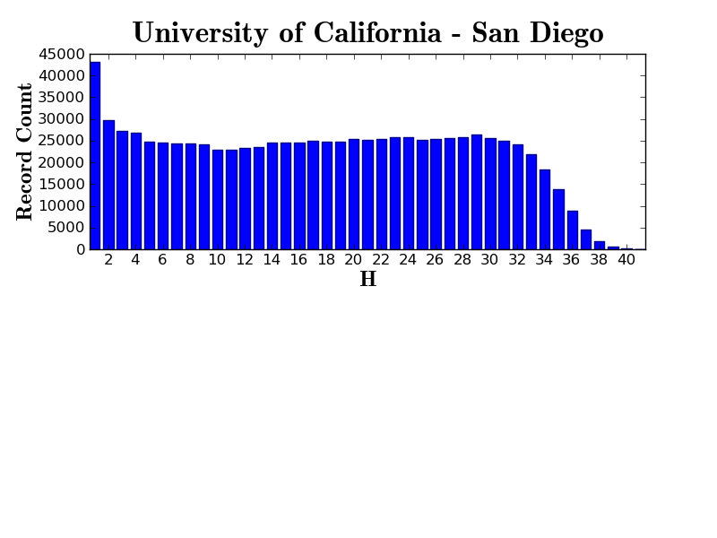

Slide 13
Distributed Print Monographs Archive Proposal
“Resolved, That the scope of activities supported through membership in HathiTrust shall include the creation and maintenance of a distributed archive of print monographs […] corresponding to the content of HathiTrust’s digital collections”
Next steps
Planning process to develop cost and service model (à la WEST)
Timetable: tbd

Slide 14
Government Documents
* As of September 24, 2011
Notes:
14

Slide 15
Government Documents
Resolved, that HathiTrust facilitate collective action to create a comprehensive digital corpus of U.S. federal publications including those issued by GPO and other federal agencies.
Extension of existing CIC project http://www.cic.net/Home/Projects/Library/BookSearch/Govdocs.aspx
Next steps
Planning process to develop operational plan and business model
Digitization and born-digital documents
Enhance access (i.e. cataloging / metadata)
Timetable: tbd (build on existing CIC project)
Synergy with UC-GILS shared print project

Slide 16
RIGHTS
Copyright Review Management System (CRMS)
Working with rights holders to open up works
Orphan works project

Slide 17
Content Distribution
9,706,923 Total volumes
2,636,483 “Public domain”
5,153,036 Book titles
255,907 Serial titles
* As of September 24, 2011
Notes:
17

Slide 18
Content Distribution
* As of September 24, 2011
Notes:
18

Slide 19
CRMS Project http://www.lib.umich.edu/imls-national-leadership-grant-crms

Slide 20
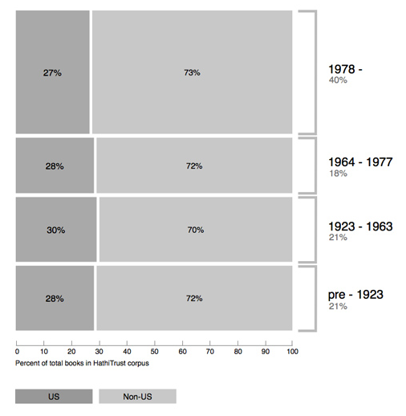
Breakdown of HathiTrust book corpus by publication date

Slide 21
Opening Up Works

Slide 22
Orphan Works http://www.lib.umich.edu/orphan-works

Slide 23
RESEARCH SERVICES

Slide 24
Services and Tools
Search services
Bibliographic and Full-text search
HathTrust catalog on WorldCat http://hathitrust.worldcat.org/
Full-text search via Summon, EBSCO, OCLC WorldCat
Integration tools
APIs: Bibliographic, Rights, Data
HathiTrust searchbox widget (CDL-developed!)
Mobile interface (new!)
Collection builder
Section 108 uses
Access for print-disabled users
Print replacements

Slide 25
Collection Builder

Slide 26
Embedding HathiTrust wherever users are working
http://www.hathitrust.org/widgets
http://m.hathitrust.org/

Slide 27
Research Center for advanced non-consumptive research http://www.hathitrust-research.org/

Slide 28
Beyond Mass Digitization
Back to the ConCon:
Mission & Goals
Development Process

Slide 29
Mission and Goals
Currently: Closely tied to print
“To build a reliable and increasingly comprehensive digital archive of library materials converted from print”
Proposed addition: Broader notion of digital assets
“To collaboratively develop cost-effective and meaningful infrastructure for ingesting digital assets of intellectual value to university scholars and the research enterprise.”
Status:
Referred back to current Executive Board for refinement
Support in principle

Slide 30
Development Process
Joint UC / Columbia / Cornell Proposal
Goals:
Broaden partner involvement in development decisions and planning
Create opportunities for a more distributed technical infrastructure

Slide 31
Like the blind men and the elephant: HathiTrust can be what we want it to be
The meaning behind the name
Hathi (hah-tee)--Hindi for elephant
Big, strong
Never forgets, wise
Secure
Trustworthy

